Slide 1

School of Electronics & Communication Engineering
Digital Image Processing VIII Sem Program Elective
18EECE414 : 3-0-0
Evaluation:
ISA1
ISA2
Assignments
Course Projects
Text Book
K Jain, “Fundamentals of Digital Image Processing”
Rafael Gonzalez,” Digital Image Processing”

Slide 2
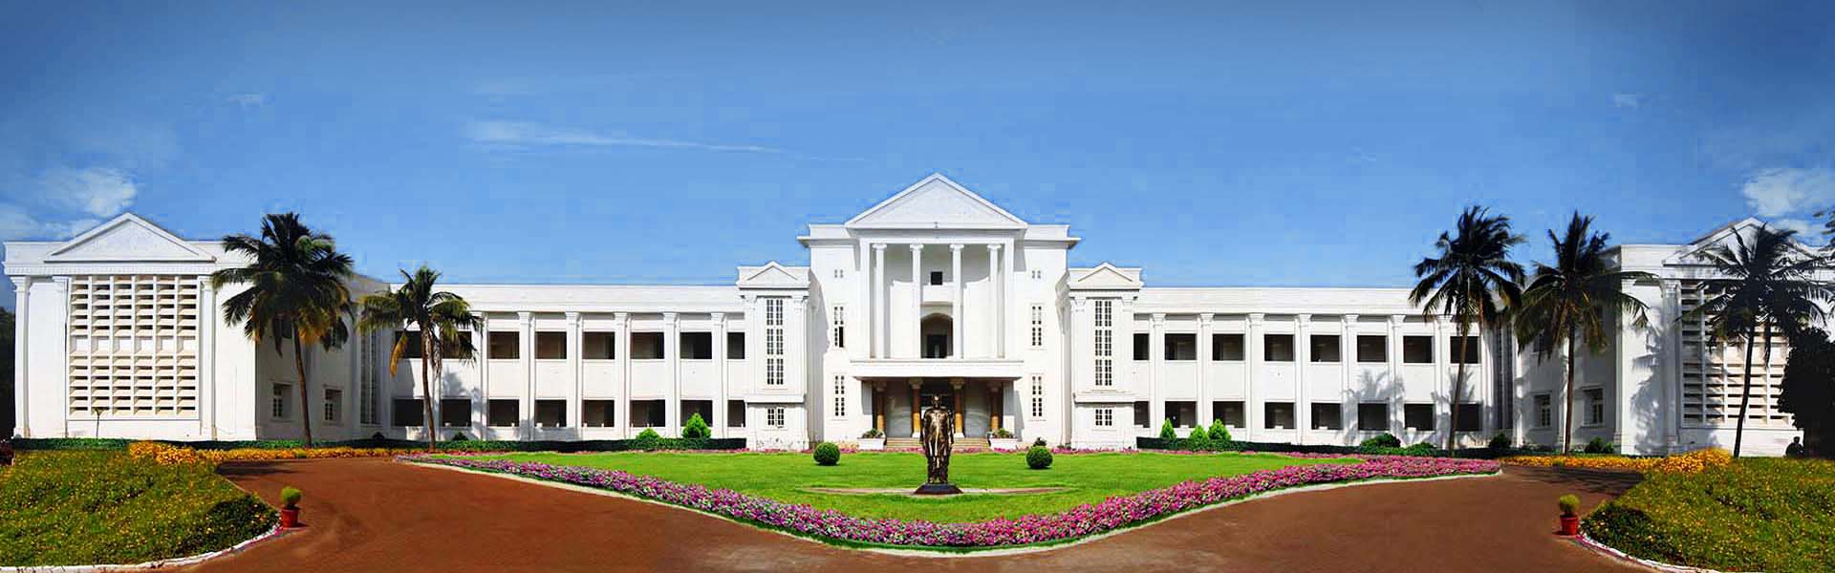
School of Electronics & Communication Engineering
You are here !!!!!!

Slide 3

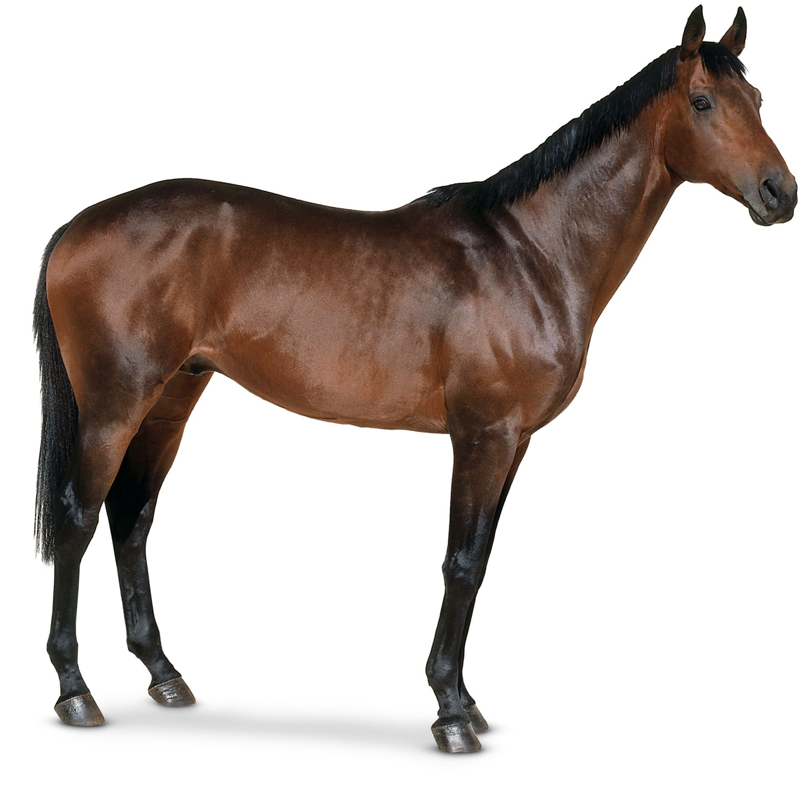

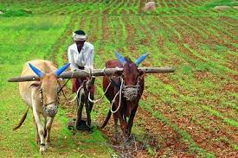

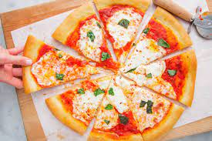

School of Electronics & Communication Engineering

Slide 4
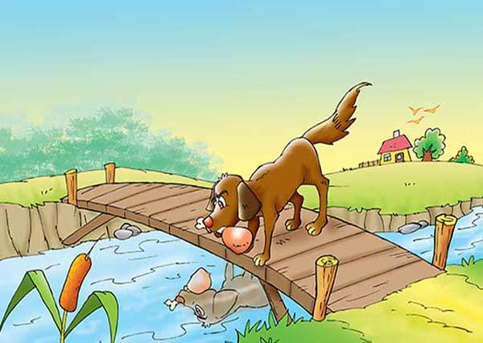

School of Electronics & Communication Engineering

Slide 5
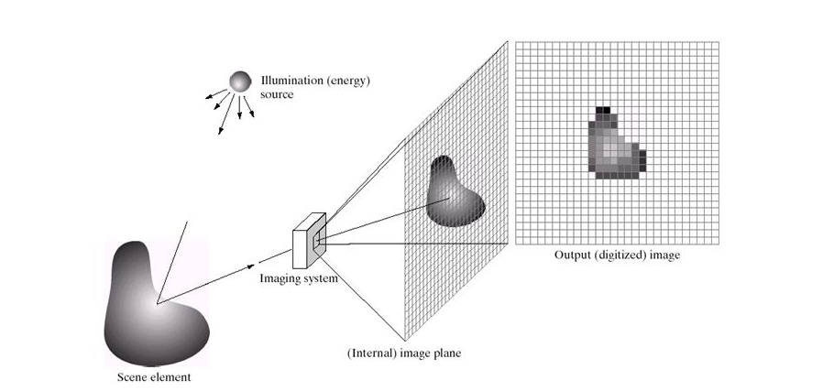
School of Electronics & Communication Engineering
What Is Image????
f(x,y)= i(x,y) r(x,y)

Slide 6
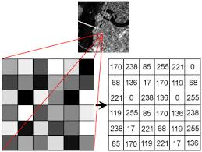
School of Electronics & Communication Engineering
Digital Image

Slide 7
School of Electronics & Communication Engineering
Why Digital Image
Storage
Transmission
Processing

Slide 8

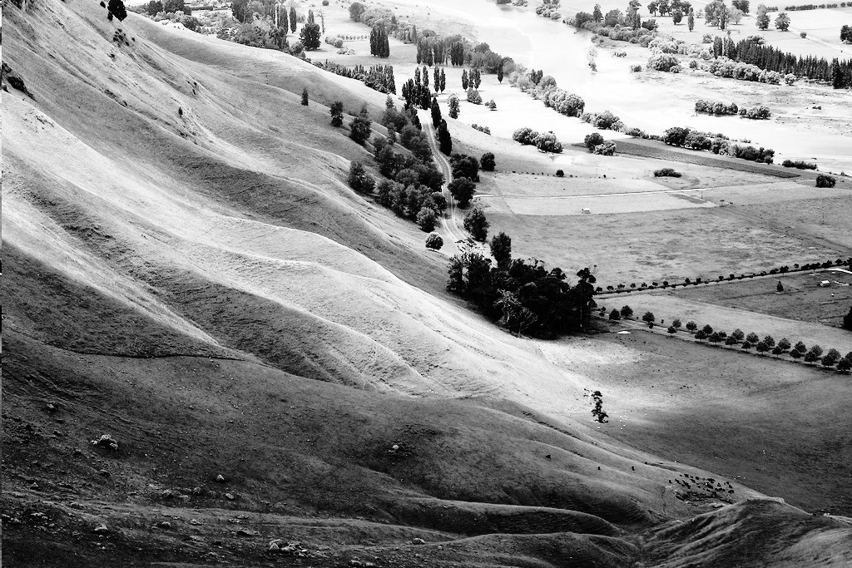
School of Electronics & Communication Engineering
Why Digital Image Processing?

Slide 9
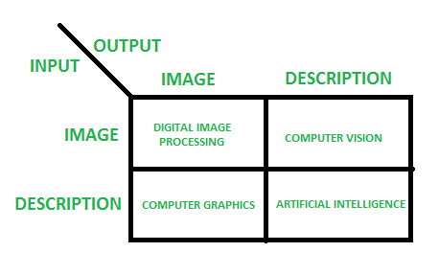
School of Electronics & Communication Engineering
Overlapping Fields of Image Processing:

Slide 10
School of Electronics & Communication Engineering
Unit - 1
Chapter No.1 Introduction: 2D systems, mathematical preliminaries- FT, Z-transform, Optical and Modulation transfer functions (OTF and MTF). | 4 hrs
Chapter No. 2 Image perception: Light, luminance, brightness, contrast, MTF of the visual system, visibility function, monochrome vision models, fidelity criteria, color representation, color models. | 4 hrs
Chapter No.3 Image sampling quantization: 2D sampling theory, limitations, sampling and reconstruction, quantization, optimal quantizer, Compander and visual quantization. | 6 hrs
Unit - 2
Chapter No. 4 Image transforms: 2D orthogonal and unitary transforms, DFT, DCT, DST, Hadamard, Harr, Slant, KLT transforms. | 8 hrs
Chapter No. 5 Image enhancement: Histograms modeling, spatial operations, transform operations, multispectral image enhancement, color image enhancement. | 10 hrs
Unit - 3
Chapter No. 6 Image filtering and restoration: Image observation models, Inverse and wiener filtering, Fourier domain filters. SVD and iterative methods. Maximum entropy restoration, Bayesian methods, co-ordinate transformation and geometric corrections | 10 hrs

Slide 11
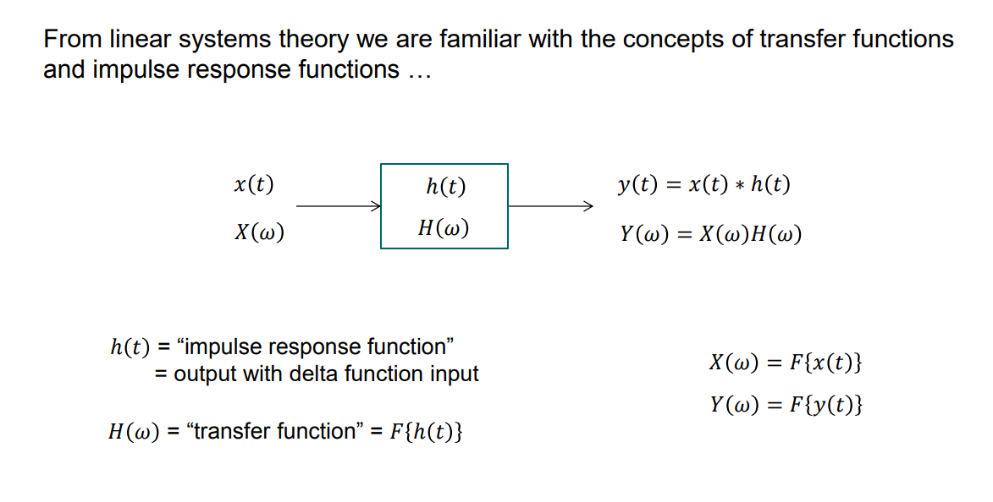
School of Electronics & Communication Engineering
Terminologies we should know:

Slide 12
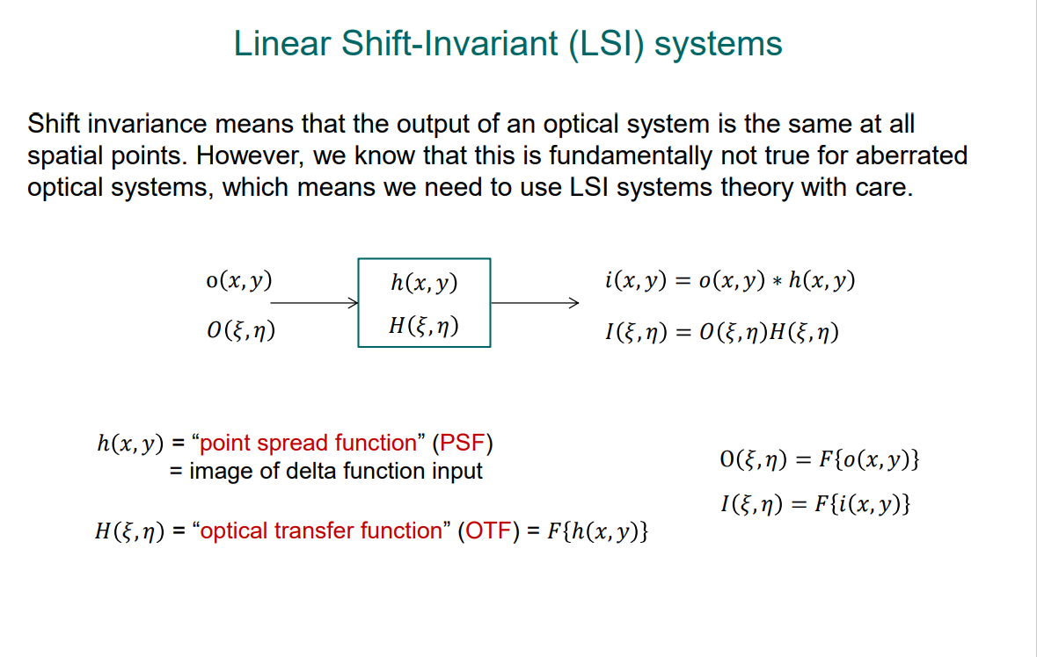
School of Electronics & Communication Engineering
Terminologies we should know:

Slide 13
School of Electronics & Communication Engineering
Terminologies we should know:
Illuminance is the quantity of light or luminous flux falling on a surface. It is measured in lumen per meter square, or lux.
Luminance is the luminous intensity projected on a given area and direction. Luminance typically describes the intensity of emitted light.
In the case of our display profiling products, we measure the luminance of the cd/m² as the unit of measure.
Brightness is what we perceive when lumens fall on the rods and cones of our retina. When we speak of brightness, we use subjective words like “dim” or “brilliant” because it cannot be measured like luminance, but it can be scaled in percentages.
Contrast is the difference in luminance or colour that makes an object (or its representation in an image or display) distinguishable.

Slide 14
School of Electronics & Communication Engineering
Sampling : related to coordinates values
(Nyquist frequency)
Quantization : related to intensity values

Slide 15
School of Electronics & Communication Engineering

Slide 16
School of Electronics & Communication Engineering

Slide 17
School of Electronics & Communication Engineering

Slide 18
School of Electronics & Communication Engineering

Slide 19
School of Electronics & Communication Engineering

Slide 20
School of Electronics & Communication Engineering

Slide 21
School of Electronics & Communication Engineering

Slide 22
School of Electronics & Communication Engineering

Slide 23
School of Electronics & Communication Engineering

Slide 24
School of Electronics & Communication Engineering

Slide 25
School of Electronics & Communication Engineering

Slide 26
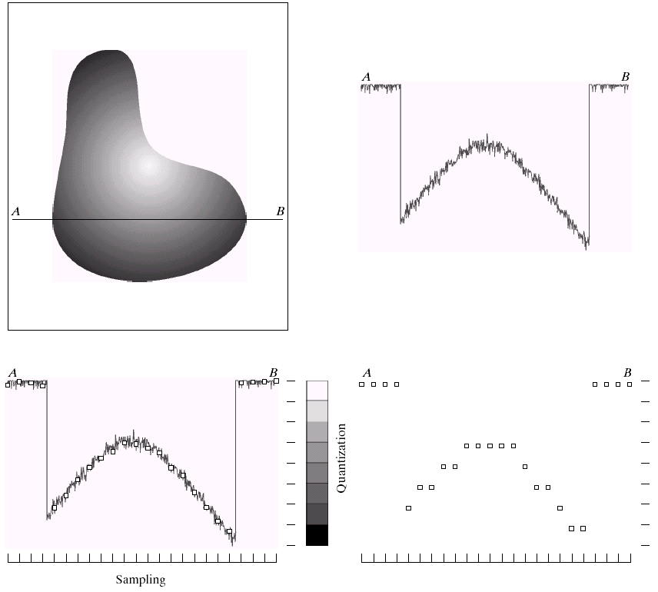
School of Electronics & Communication Engineering
a | b
c | d
Generating a digital image. (a) Continuous image. (b) A scaling line from A to B in the continuous image, used to illustrate the concepts of sampling and quantization. (c) sampling and quantization. (d) Digital scan line.

Slide 27

School of Electronics & Communication Engineering
a | b
(a) Continuous image projected onto a sensor array. (b) Result of image sampling and quantization.

Slide 28

School of Electronics & Communication Engineering
0 | 0 | 0 | 75 | 75 | 75 | 128 | 128 | 128 | 128
0 | 75 | 75 | 75 | 128 | 128 | 128 | 255 | 255 | 255
75 | 75 | 75 | 200 | 200 | 200 | 255 | 255 | 255 | 200
128 | 128 | 128 | 200 | 200 | 255 | 255 | 200 | 200 | 200
128 | 128 | 128 | 255 | 255 | 200 | 200 | 200 | 75 | 75
175 | 175 | 175 | 225 | 225 | 225 | 75 | 75 | 75 | 100
175 | 175 | 100 | 100 | 100 | 225 | 225 | 75 | 75 | 100
75 | 75 | 75 | 35 | 35 | 35 | 0 | 0 | 0 | 35
35 | 35 | 35 | 0 | 0 | 0 | 35 | 35 | 35 | 75
75 | 75 | 75 | 100 | 100 | 100 | 200 | 200 | 200 | 200

Slide 29
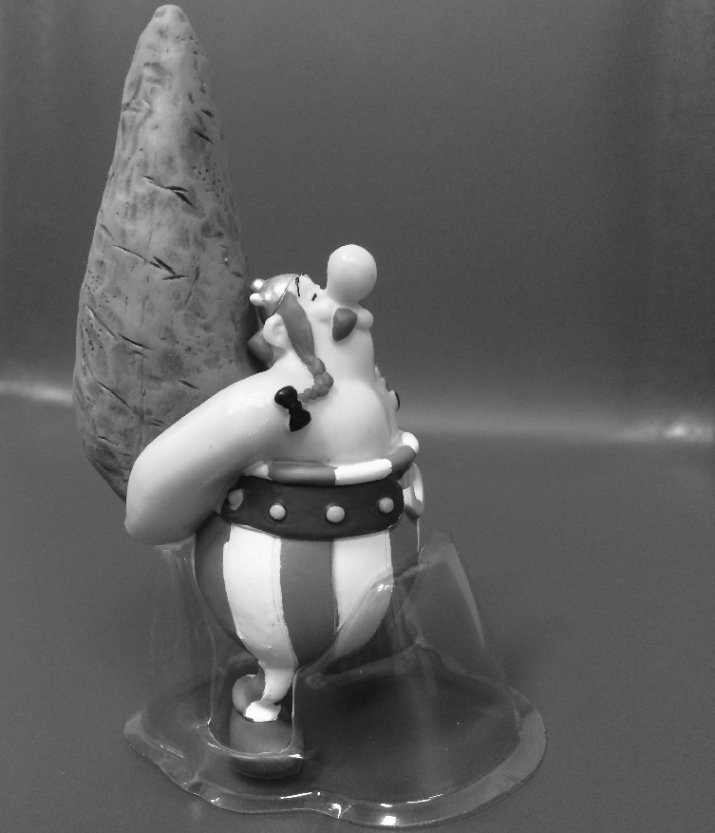
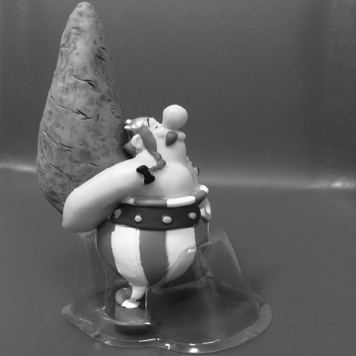

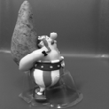
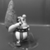
School of Electronics & Communication Engineering
Sampling
32
64
128
256
512
1024

Slide 30
School of Electronics & Communication Engineering
Sampling
1024
512
256
128
64
34

Slide 31
School of Electronics & Communication Engineering
Quantization
8-Bit
7-Bit
6-Bit
5-Bit
4-Bit
3-Bit
2-Bit
1-Bit

Slide 32
School of Electronics & Communication Engineering
F(x, y) is Digital image ,
L, number of intensity levels used for quantization.
L=2^k, Span is called Dynamic Range
Dynamic Range of imaging system = Ratio of maximum measurable intensity to the minimum detectable intensity

Slide 33
School of Electronics & Communication Engineering
Upper limit is saturation and lower limit is noise
Saturation: highest value beyond which all intensity level are clipped
Contrast : difference between the highest and the lowest intensity value.
Lower dynamic range image looks dull

Slide 34
School of Electronics & Communication Engineering
Special Resolution:
Number of discernable lines or dots per unit area. (DPI)
News paper, 75 DPI Magazines, 133 DPI
Glossy prints, 175 DPI Books, 2400 DPI
Intensity resolution: Number of quantization levels
For L=256, intensity resolution is 8
Number of bits required to
store digital image, b
b= M X N X K
If L= 256, = 2^8
i.e 8 bit image

Slide 35
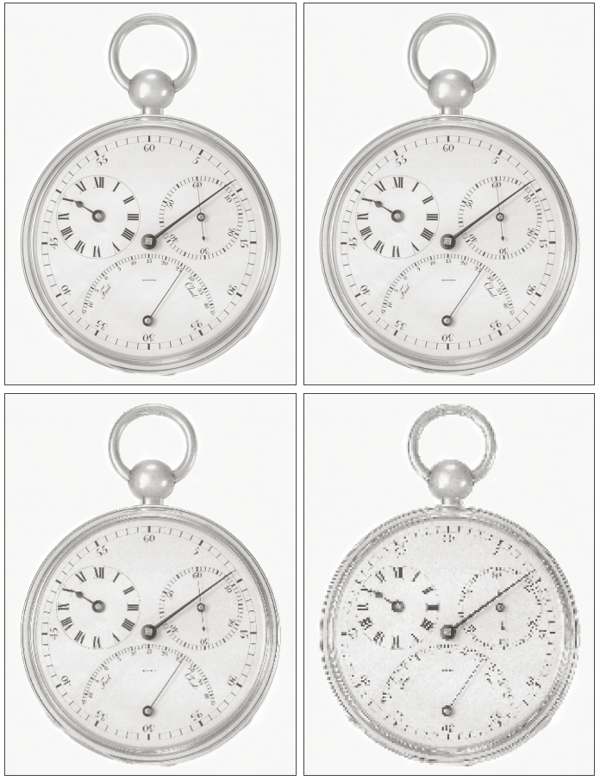
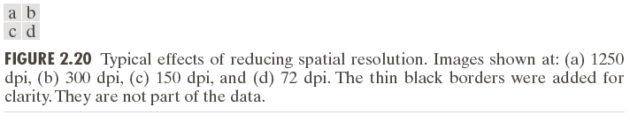
School of Electronics & Communication Engineering

Slide 36
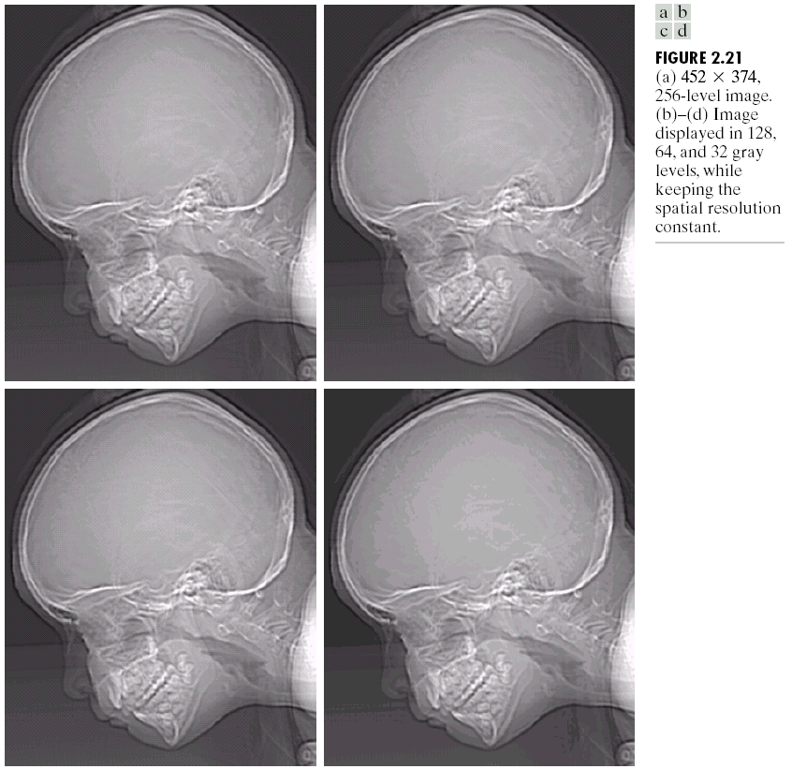
School of Electronics & Communication Engineering

Slide 37
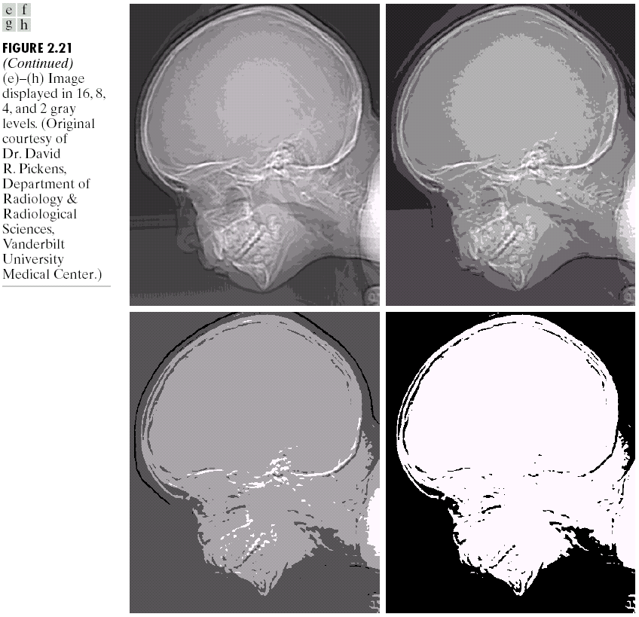
School of Electronics & Communication Engineering

Slide 38
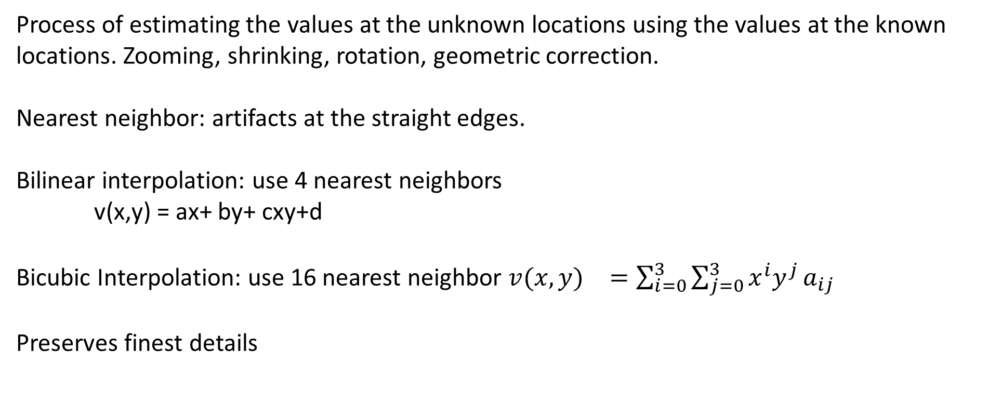
School of Electronics & Communication Engineering
Image Interpolation:
Process of estimating the values at the unknown locations using the values at the known locations. Zooming, shrinking, rotation, geometric correction.
Nearest neighbor: artifacts at the straight edges.
Bilinear interpolation: use 4 nearest neighbors
v(x,y) = ax+ by+ cxy+d
Bicubic Interpolation: use 16 nearest neighbor ${v(x,y)}^{}=\sum_{i=0}^{3}{\sum_{j=0}^{3}{x^{i}y^{j}}}a_{ij}$
Preserves finest details

Slide 39
School of Electronics & Communication Engineering
Basic Relationships between pixels
Neighbors of a pixel of p at (x,y) are
N4(p)=(x+1,y), (x-1,y), (x,y+1),(x,y+1)= unit distant
Diagonal neighbors are
ND(p)=(x+1,y-1), (x+1,y+1), (x-1,y+1),(x-1,y-1)
N8(p)=N4(p)+ND(P)

Slide 40
School of Electronics & Communication Engineering
Basic Relationships between pixels: Adjacency, Connectivity, region, boundaries
V= set of intensity values defining the adjacency. For binary image, v={1}, for gray scale image with 256 levels, v is subset of 256
4- Adjacency: Two pixels p and q with values from V are 4 adjacent if q is in the set of N4(p)
8- adjacency: Two pixels p and q with values from V are 8 adjacent if q is in the set of N8(p)
M adjacency: Two pixels p and q with values from V are m adjacent if
q is in N4(p) or
q is in ND(p) and the set of N4(P) Ո N4(q) has no values are from V

Slide 41
School of Electronics & Communication Engineering
Basic Relationships between pixels: Adjacency, Connectivity, region, boundaries
Digital path from pixel p(x,y) to q(s,t) is a set of distinct pixels with coordinates (x0,y0), (x1,y1)……….(xn,yn)
(x0,y0)=(x,y) and (xn,yn)=(s,t) and (xi,yi) and (xi-1,yi-1) are adjacent pixels.
If (x0,y0)=(xn,yn) then it is a closed path.
Let S= subset of pixel
P and q pixels are said to be connected in S, if there exists path
between the consisting entirely of Pixels in S.
For pixel p in S, the set of all pixels connected to it in S are called connected component of S. if it only has one connected component, it is called connected set.

Slide 42
School of Electronics & Communication Engineering
Basic Relationships between pixels: Adjacency, Connectivity, Region, Boundaries
R= subset of pixel in an image. R is a region of image if it is a connected set.
Region could be adjacent or disjoint
If there are K disjoint regions, and Ru is union of all K and Ru’ is complement of Ru, Ru is foreground and Ru’ is background.
The boundary of region R is a set of pixels in the region that have at least one neighbor in the background.
Edge is measure of discontinuity.

Slide 43
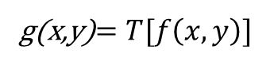
School of Electronics & Communication Engineering
Agenda:
Intensity Transformations and Spatial Filtering.
A 3 X 3 neighborhood about a point (x, y) in an image in the spatial domain. The neighborhood is moved from pixel to pixel in an image to generate an output image.
Intensity transformations: operate on single image and the purpose is contrast manipulation and thresholding.
Spatial filters: operate on neighborhood and the purpose is to blur or sharpen the image.
g(x,y)$=T[f\left(x,y\right)]$

Slide 44
School of Electronics & Communication Engineering
Intensity Transformation Functions:
s: intensity of g
r: intensity of f
Contrast stretching
Thresholding Function

Slide 45
School of Electronics & Communication Engineering
Intensity Transformation Functions: Enhancement
Intensity transformations:
Linear(Negative and identity),
Logarithmic (log and inverse log),
power law (nth power and nth root)
Image negative : $s=L−1−r$, L=256

Slide 46
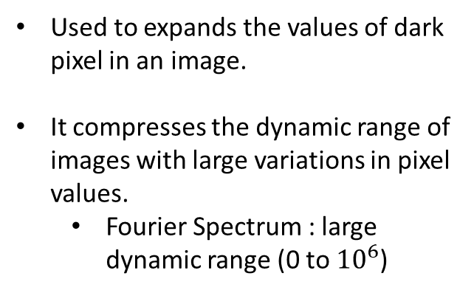
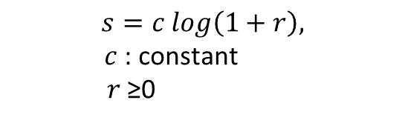
School of Electronics & Communication Engineering
Intensity Transformation Functions: Enhancement
Log Transformations:
$$s=c log\left(1+r\right),$$
$c$: constant
$r$≥0
Used to expands the values of dark pixel in an image.
It compresses the dynamic range of images with large variations in pixel values.
Fourier Spectrum : large dynamic range (0 to ${10}^{6}$)
Fourier spectrum scaled linearly to for display in an 8-bit system. Bright pixel overrides the other.
After applying log function

Slide 47
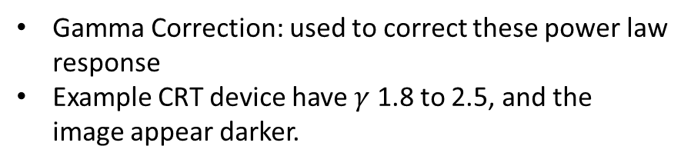
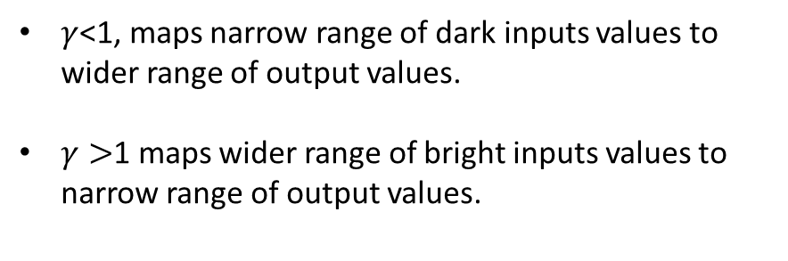

School of Electronics & Communication Engineering
Intensity Transformation Functions: Enhancement
Power-Law(Gamma)Transformation
$$s=cr^{γ}$$
$c, γ$: + ve constants
$γ$<1, maps narrow range of dark inputs values to wider range of output values.
$γ>$1 maps wider range of bright inputs values to narrow range of output values.
Gamma Correction: used to correct these power law response
Example CRT device have $γ$ 1.8 to 2.5, and the image appear darker.
Power-Law transformations for $c$=1

Slide 48
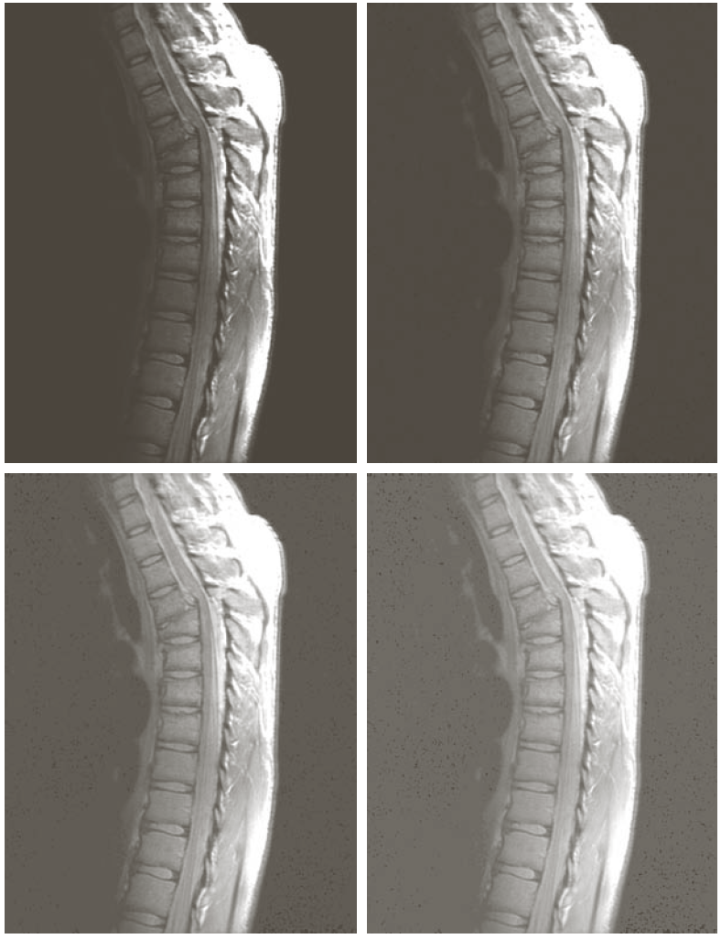
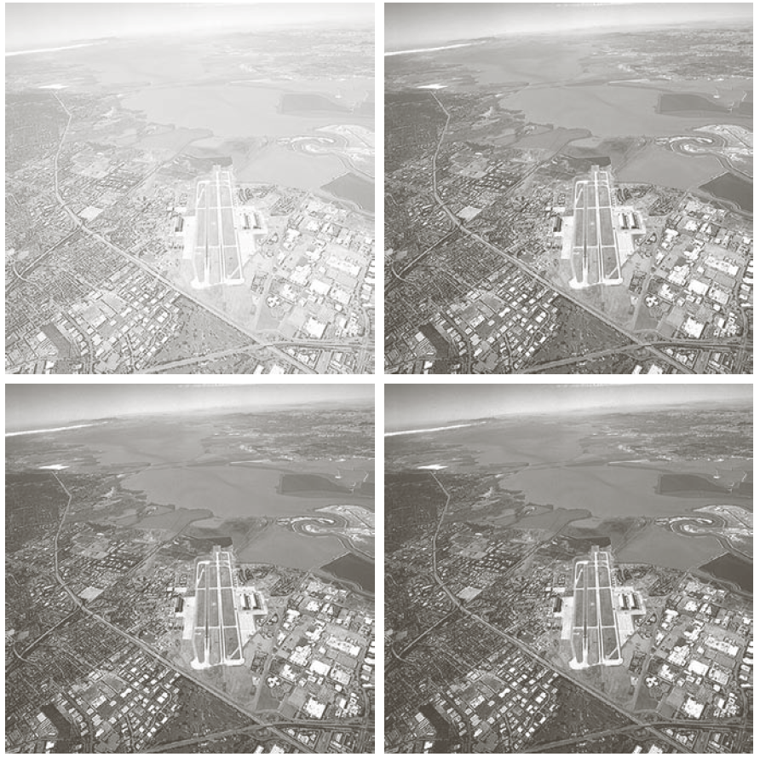
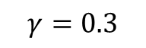
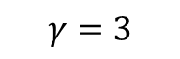
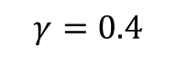
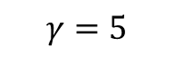
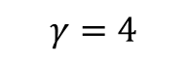

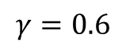
School of Electronics & Communication Engineering
Intensity Transformation Functions: Enhancement
Power-Law(Gamma)Transformation
$$s=cr^{γ}$$
$$γ=0.6$$
$$γ=3$$
$$γ=0.4$$
$$γ=0.3$$
$$γ=4$$
$$γ=5$$

Slide 49
School of Electronics & Communication Engineering
Intensity Transformation Functions: Enhancement
Piecewise –Linear Transformation Function:
Advantages : Modeling is arbitrarily complex
Disadvantages: needs more user input.
Contrast stretching: Expands the range of intensity levels in an image in align with recording or display device.

Slide 50
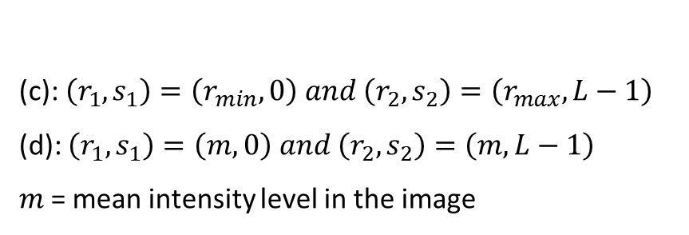
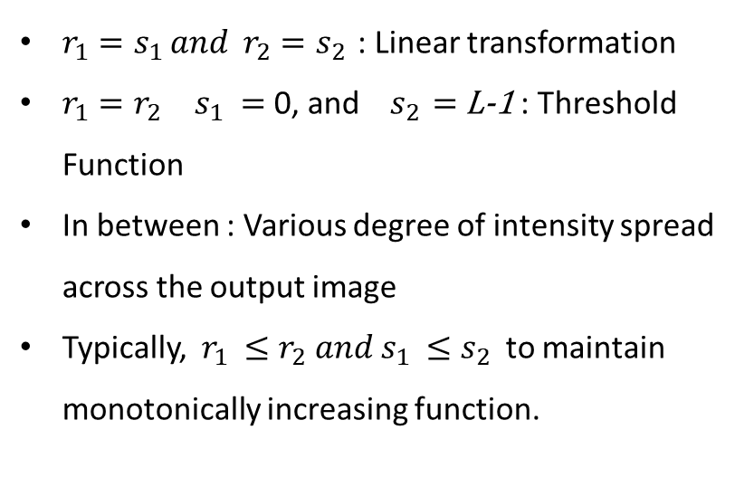
School of Electronics & Communication Engineering
Intensity Transformation Functions: Enhancement
(a)
(b)
Contrast stretching:
$r_{1}=s_{1 }and{ r}_{2}=s_{2 }$: Linear transformation
$r_{1}=r_{2 }{ s}_{1 }=$ 0, and ${ s}_{2 }=$ L-1 : Threshold Function
In between : Various degree of intensity spread across the output image
Typically, $r_{1 }≤r_{2} and s_{1 }≤s_{2}$ to maintain monotonically increasing function.
(c): $\left(r_{1},s_{1}\right)=\left(r_{min}, 0\right) and \left(r_{2},s_{2}\right)=\left(r_{max}, L−1\right)$
(d): $\left(r_{1},s_{1}\right)=\left(m, 0\right) and \left(r_{2},s_{2}\right)=\left(m, L−1\right)$
$m$= mean intensity level in the image
(c) Contrast stretched image
(d) Binary image

Slide 51
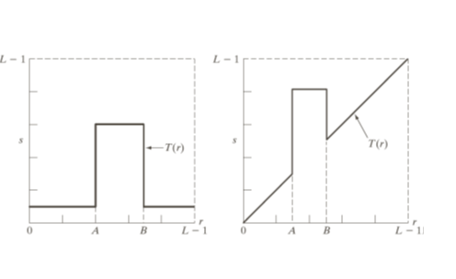
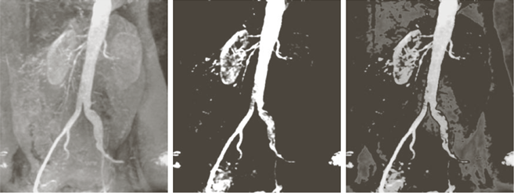
School of Electronics & Communication Engineering
Intensity Transformation Functions: Enhancement
Intensity –level slicing:
Highlights the particular region of interest (ROI)
Highlights ROI and makes other all Zero
Highlights ROI without changing others

Slide 52
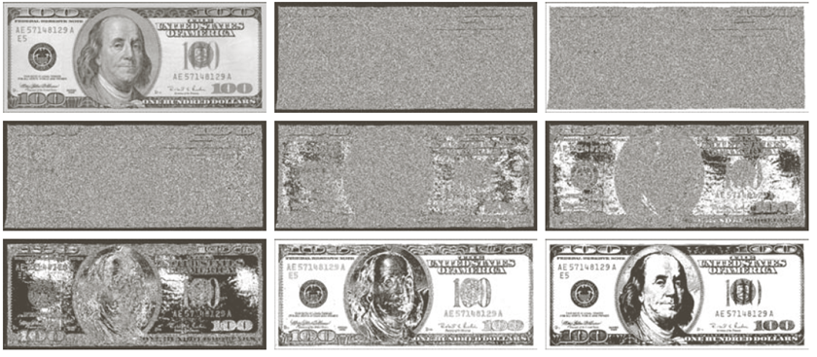
School of Electronics & Communication Engineering
Intensity Transformation Functions: Enhancement
Bit Plane slicing:
Highlight the contribution made by the pixel towards the appearance of an image, and decide the number of bits necessary for quantization.
Used in Compression
Higher order bits contain more information

Slide 53

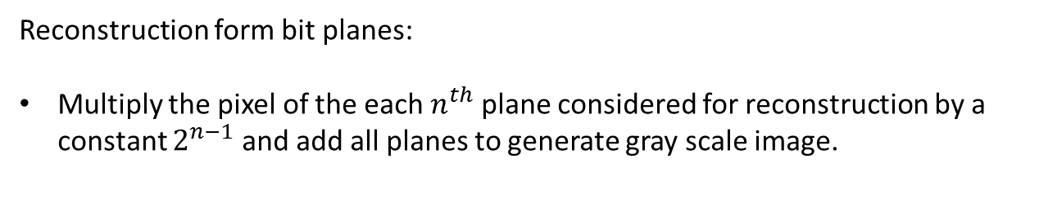
School of Electronics & Communication Engineering
Intensity Transformation Functions: Enhancement
Reconstruction form bit planes:
Multiply the pixel of the each $n^{th}$ plane considered for reconstruction by a constant $2^{n−1}$ and add all planes to generate gray scale image.
Used bit plane 8 and 7
(more flat )
Used bit plane 8 , 7 and 6
(false contours at the background)
Used bit plane 8, 7, 6 and 5

Slide 54
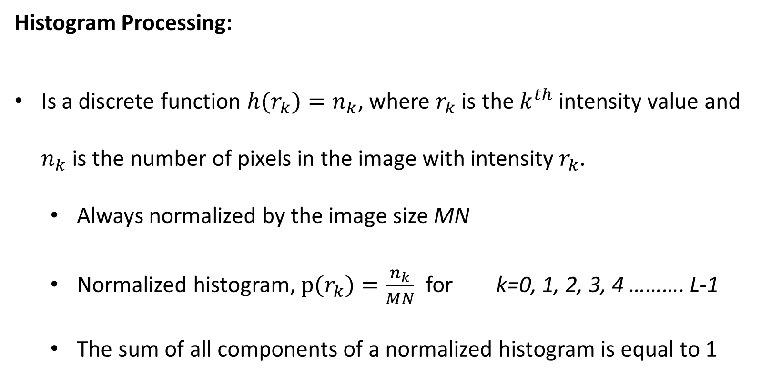
School of Electronics & Communication Engineering
Histogram Processing:
Is a discrete function $h(r_{k})=n_{k}$, where $r_{k}$ is the $k^{th}$ intensity value and $n_{k}$ is the number of pixels in the image with intensity $r_{k}$.
Always normalized by the image size MN
Normalized histogram, $p(r_{k})=\frac{n_{k}}{MN}$ for k=0, 1, 2, 3, 4 ………. L-1
The sum of all components of a normalized histogram is equal to 1

Slide 55
School of Electronics & Communication Engineering
Histogram Processing: Enhancement
Image whose pixel tend to occupy the entire range of possible intensity levels and tend to be distributed uniformly will have higher contrast and high dynamic range.
Dark image, crowded near lower bins
Light image, crowded near higher bins
Low contrast image (dull), crowded at narrow range
High contrast image, spread across the entire range

Slide 56
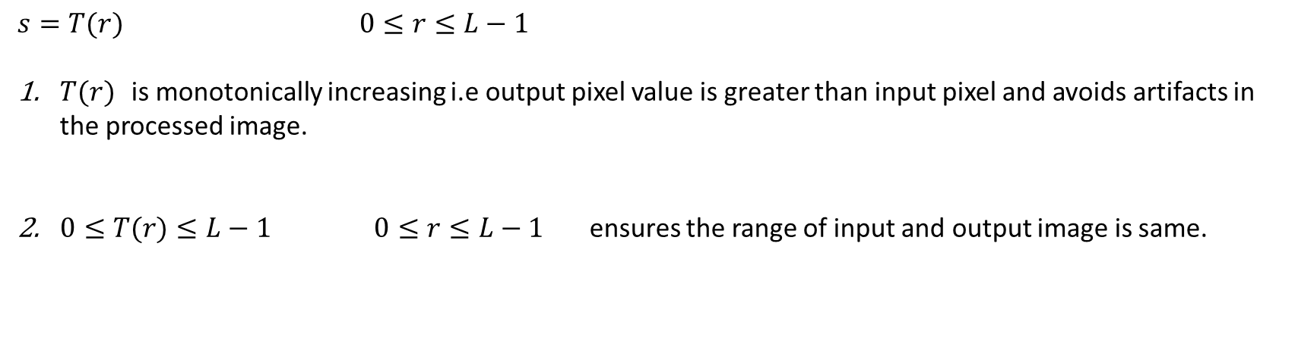
School of Electronics & Communication Engineering
Histogram Processing: Enhancement
Histogram Equalization:
$s=T(r)$ $0≤r≤L−1$
$T(r)$ is monotonically increasing i.e output pixel value is greater than input pixel and avoids artifacts in the processed image.
$0≤T(r)≤L−1$ $0≤r≤L−1$ ensures the range of input and output image is same.

Slide 57
School of Electronics & Communication Engineering
Histogram Processing: Enhancement
Many to one Mapping
Not possible to recover r from s
One to one Mapping
Possible to recover r from s

Slide 58
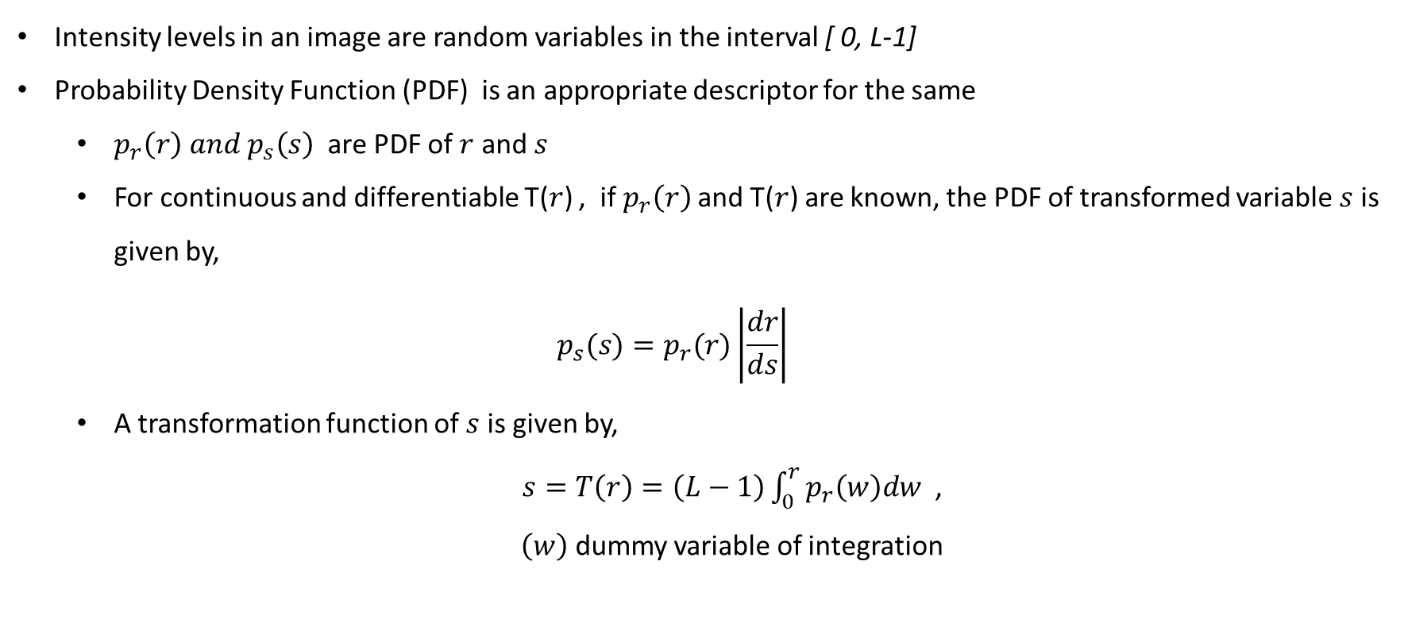
School of Electronics & Communication Engineering
Histogram Processing: Enhancement
Intensity levels in an image are random variables in the interval [ 0, L-1]
Probability Density Function (PDF) is an appropriate descriptor for the same
$p_{r}\left(r\right) and{ p}_{s}\left(s\right)$ are PDF of $r$ and $s$
For continuous and differentiable T($r$) , if $p_{r}\left(r\right)$and T($r$) are known, the PDF of transformed variable $s$ is given by,
$$p_{s}(s)=p_{r}(r)\left|\frac{dr}{ds}\right|$$
A transformation function of $s$ is given by,
$s=T\left(r\right)=\left(L−1\right)\int_{0}^{r}{p_{r}\left(w\right)dw}$ ,
$\left(w\right)$ dummy variable of integration

Slide 59
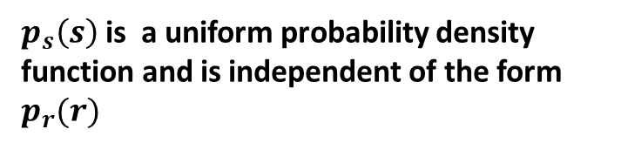
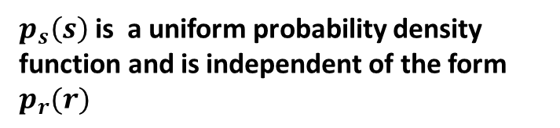
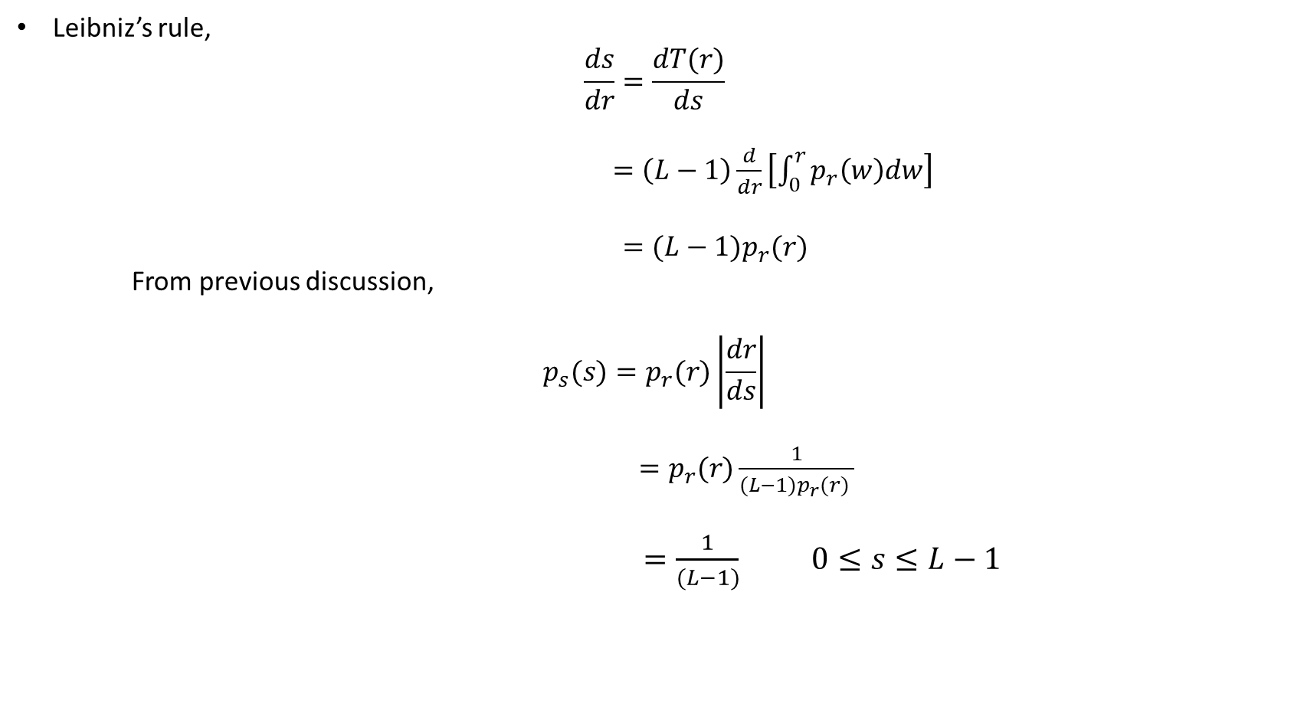
School of Electronics & Communication Engineering
Histogram Processing: Enhancement
Leibniz’s rule,
$$\frac{ds}{dr}=\frac{dT(r)}{ds}$$
$=\left(L−1\right)\frac{d}{dr}\left[\int_{0}^{r}{p_{r}\left(w\right)dw}\right]$
$=(L−1)p_{r}(r)$
From previous discussion,
$$p_{s}(s)=p_{r}(r)\left|\frac{dr}{ds}\right|$$
$=p_{r}(r)\frac{1}{(L−1)p_{r}(r) }$
$=\frac{1}{(L−1)}$ $0≤s≤L−1$
$p_{s}\left(s\right)$is a uniform probability density function and is independent of the form $p_{r}(r)$
$p_{s}\left(s\right)$is a uniform probability density function and is independent of the form $p_{r}(r)$

Slide 60
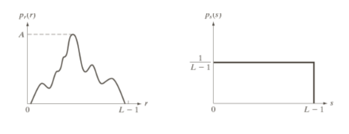
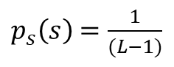

School of Electronics & Communication Engineering
Histogram Processing: Enhancement
$p_{s}\left(s\right)$is a uniform probability density function and is independent of the form $p_{r}(r)$
$$p_{r}(r)$$
$p_{s}\left(s\right)$ $=\frac{1}{(L−1)}$

Slide 61
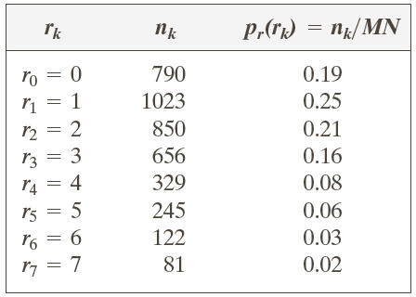
School of Electronics & Communication Engineering
Histogram Processing: Enhancement
Example 1:
Suppose that a 3-bit image (L=8) of size 64X64 pixel (MN=4096) has the intensity distribution shown below, the intensity levels are in integers in the range [0, L-1]= [0,7]. Find the values of equalized histogram.

Slide 62
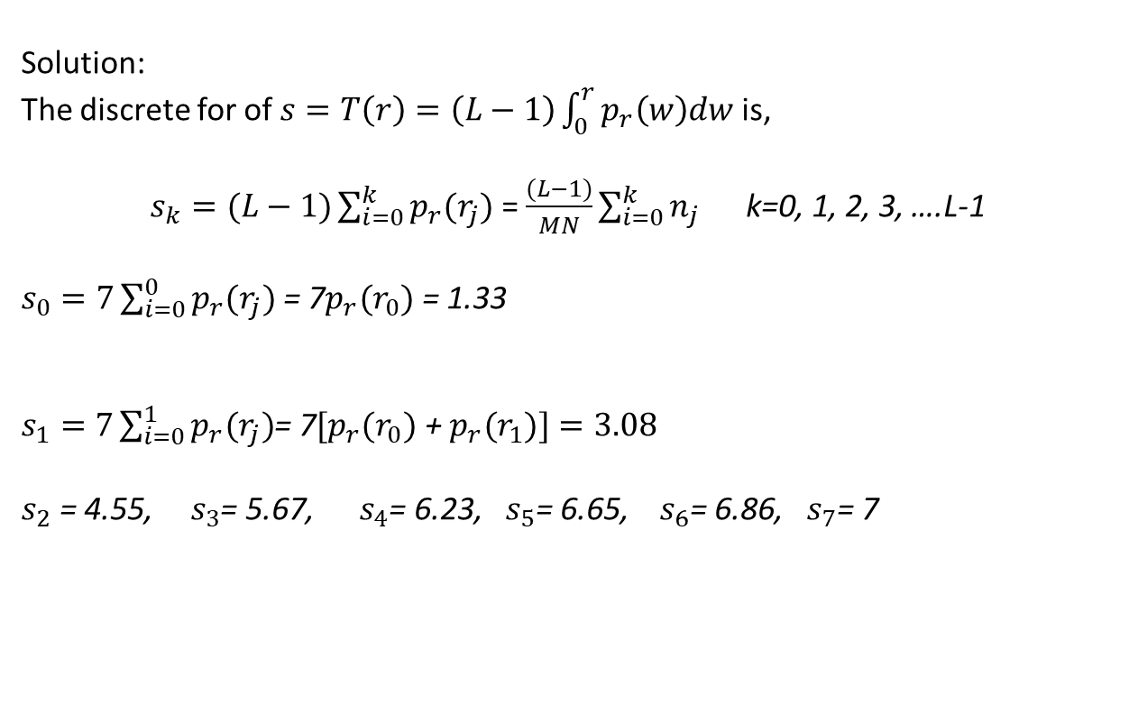
School of Electronics & Communication Engineering
Histogram Processing: Enhancement
Solution:
The discrete for of $s=T\left(r\right)=\left(L−1\right)\int_{0}^{r}{p_{r}\left(w\right)dw}$ is,
$s_{k}=(L−1)\sum_{i=0}^{k}{p_{r}(r_{j}})$ = $\frac{(L−1)}{MN}\sum_{i=0}^{k}{n_{j} }$ k=0, 1, 2, 3, ….L-1
$s_{0}=7\sum_{i=0}^{0}{p_{r}(r_{j}})$ = 7$p_{r}(r_{0})$ = 1.33
$s_{1}=7\sum_{i=0}^{1}{p_{r}(r_{j}})$= 7${[p}_{r}(r_{0})$ + $p_{r}(r_{1})]=3.08$
$s_{2}$ = 4.55, $s_{3}$= 5.67, $s_{4}$= 6.23, $s_{5}$= 6.65, $s_{6}$= 6.86, $s_{7}$= 7

Slide 63

School of Electronics & Communication Engineering
Histogram Processing: Enhancement
Histogram is an approximation to a PDF and no new allowed intensity values are created, perfectly flat histograms are rare.

Slide 64
School of Electronics & Communication Engineering
Histogram Processing: Enhancement
1
2
3
Transformation functions for histogram equalization
4

Slide 65

School of Electronics & Communication Engineering
Histogram Processing (Histogram Specification): Enhancement
Generates a processed image that has a specified histogram.
Let $r, z$ : continuous random variable denoting intensities of input and specified images.
$p_{r}\left(r\right),{ p}_{z}(z)$: corresponding PDF
S: random variable with the property,
$s=T\left(r\right)=\left(L−1\right)\int_{0}^{r}{p_{r}\left(w\right)dw}$ continue version of histogram equalization,
$z$ is defined as random variable with the property,
$$G\left(z\right)=\left(L−1\right)\int_{0}^{z}{p_{z}\left(t\right)dt=s}$$
$G\left(z\right)$= $T\left(r\right)$ and $z$ must satisfy, $z=G^{−1}T(r)$= $G^{−1}(s)$

Slide 66


School of Electronics & Communication Engineering
Histogram Processing (Histogram Specification): Enhancement
Steps for histogram specification:
Obtain $p_{r}\left(r\right)$ to obtain the value of s using $s=T\left(r\right)=\left(L−1\right)\int_{0}^{r}{p_{r}\left(w\right)dw}$
Use specified PDF${ p}_{z}\left(z\right)$ to obtain the transformation function $G\left(z\right)$
Obtain the inverse transformation $z=G^{−1}(s)$, mapping $s$ to $z$
Obtain the output equalized image i.e $s$ is obtained, and perform inverse mapping
$z=G^{−1}(s)$,
Example 2:
Consider 64 X 64 hypothetical image whose histogram is shown in the Figure. It is desired to transform this histogram according to the second column of the table. Sketch the histogram of the image you obtain after applying histogram specification.

Slide 67


School of Electronics & Communication Engineering
Histogram Processing (Histogram Specification): Enhancement
Step-1 We have solved for s in the previous example,
${s_{0}=1,{ s}_{1}=3, s}_{2}$ = 5, $s_{3}$= 6, $s_{4}$= 6, $s_{5}$= 7, $s_{6}$= 7, $s_{7}$= 7

Slide 68

School of Electronics & Communication Engineering
Histogram Processing: Enhancement
Step-2 Compute of all values of transformation function $G\left(z\right)$
$$G(z_{q})=(L−1)\sum_{i=0}^{q}{p_{z}(z_{i}})$$
$G(z_{0})=7\sum_{i=0}^{0}{p_{z}(z_{i}})$ = 0.0
$G(z_{1})=7\sum_{i=0}^{1}{p_{z}(z_{i}})$= 0.00=0
$G(z_{2})=7\sum_{i=0}^{2}{p_{z}(z_{i}})$= 0.00=0
$G(z_{3})=7\sum_{i=0}^{3}{p_{z}(z_{i}})$= 7[0+0+0+0.15]=1.05=1
$G(z_{4})=7\sum_{i=0}^{4}{p_{z}(z_{i}})$= 7[0+0+0+0.15+0.20]=2.45=2
$G(z_{5})=7\sum_{i=0}^{5}{p_{z}(z_{i}})$= 7[0+0+0+0.15+0.20+0.30]=4.55=5
$G(z_{6})=7\sum_{i=0}^{6}{p_{z}(z_{i}})$= 7[0+0+0+0.15+0.20+0.30+0.20]=5.95=6
$G(z_{7})=7\sum_{i=0}^{7}{p_{z}(z_{i}})$= 7[0+0+0+0.15+0.20+0.30+0.20+0.15]=7
${s_{0}=1,{ s}_{1}=3, s}_{2}$ = 5, $s_{3}$= 6, $s_{4}$= 6, $s_{5}$= 7, $s_{6}$= 7, $s_{7}$= 7

Slide 69



School of Electronics & Communication Engineering
Histogram Processing: Enhancement
Transformation function obtained from the specified histogram, it is not monotonically increasing.
Step-3
Find the smallest value of $z_{q}$ so that ${G(z}_{q})$ is closest to $s_{k}$ , i. e mapping of $s$ to $z$.
Ex: $s_{0}=1$, and we observe, $G(z_{3})$=1, and we map $s_{0}$ to $z_{3}$, every pixel whose value is 1 in the histogram equalized image, is mapped to the pixel valued 3 in the histogram specified image.
${s_{0}=1,{ s}_{1}=3, s}_{2}$ = 5, $s_{3}$= 6, $s_{4}$= 6, $s_{5}$= 7, $s_{6}$= 7, $s_{7}$= 7

Slide 70


School of Electronics & Communication Engineering
Histogram Processing: Enhancement
Histogram of
specified image
$s_{k}=1$ maps to $z_{q}$=3, ($s_{0}$=1 , and $r_{0}$ had been mapped to it and there are 790 pixels with intensity $r_{0}$ ) therefore $p_{z}$($z_{3}$)= 790/4096 =0.19
$s_{k}=3$ maps to $z_{q}$=4, ($s_{1}$=3 and $r_{1}$ had been mapped to it, there are 1023 pixels with intensity $r_{1}$) , therefore $p_{z}$($z_{4}$)= 1023/4096 =0.25
$s_{k}=5$ maps to $z_{q}$=5, ($s_{2}$=5 and $r_{2}$ had been mapped to it, there are 850 pixels with intensity $r_{2}$) , therefore $p_{z}$($z_{5}$)= 850/4096 =0.2075
$s_{k}=6$ maps to $z_{q}$=6, ($s_{3}$= $s_{4}=$6 and $r_{3 }and r_{4}$ had been mapped to it, there are 985 pixels with intensity $r_{3}$ and $r_{4}$ ) , therefore $p_{z}$($z_{6}$)= 985/4096 =0.24
$s_{k}=7$ maps to $z_{q}$=7, ($s_{5}$= $s_{6}=s_{7}=$7and $r_{5}and r_{6}$ $,r_{7 }$had been mapped to it, there are 448 pixels with intensity $r_{5}$ and $r_{6}$ and $r_{7}$) , therefore $p_{z}$($z_{7}$)= 448/4096 =0.11

Slide 71

School of Electronics & Communication Engineering
Local Histogram Processing: Enhancement
Global Histogram Enhancement and local histogram enhancement.
Global histogram technique: pixels are modified by the transformation function based on the intensity distribution of the entire image.
Local histogram technique: Transformation function based on the intensity distribution in a neighborhood of every pixel .
Used to enhance details over small areas in an image.
Define a neighborhood and move its center from pixel to pixel.
Compute histogram and using histogram specification or histogram equalization, center pixel is mapped.
Neighborhood is slided across the image.
Original Image
Global hist. Equalization
Local hist. Equalization

Slide 72

School of Electronics & Communication Engineering
Histogram Processing (Histogram Statistics): Enhancement
$r:$Discrete random variable representing intensity value in the range [0, L-1]
$p(r_{i}):$ Normalized histogram and is an estimate of the probability that intensity $r_{i}$ occurs in the image.
$n^{th}$ moment of $r$ about its mean µ is,
${\text{µ}}_{n}\left(r\right)=\sum_{i=0}^{L−1}{{\left(r_{i}−m\right)}^{n} p\left(r_{i}\right)},$ $m:mean value of r$
$$m=\sum_{i=0}^{L−1}{r_{i} p\left(r_{i}\right)}$$
The second moment is,
${\text{µ}}_{2}\left(r\right)=\sum_{i=0}^{L−1}{{\left(r_{i}−m\right)}^{2} p\left(r_{i}\right)}$, and is intensity variance
Mean: Avg Intensity
Variance or std deviation : measure of contrast.

Slide 73

School of Electronics & Communication Engineering
Histogram Processing : Enhancement
Sample mean and sample variance:
$$m=\frac{1}{MN}\sum_{x=0}^{M−1}{\sum_{y=0}^{N−1}{f(x,y)}}$$
$${\text{σ}}^{2}=\frac{1}{MN}\sum_{x=0}^{M−1}{\sum_{y=0}^{N−1}{{f(x,y−m)}^{2}}}$$

Slide 74


School of Electronics & Communication Engineering
Histogram Processing: Enhancement

Slide 75
School of Electronics & Communication Engineering
Spatial Filtering: Enhancement
Filters:
Low pass filters:
High pass filters:
Bandpass filters:
Band eliminations filters:
Many …….

Slide 76


School of Electronics & Communication Engineering
Spatial Filtering: Enhancement
Linear filtering: operations performed on the
image then filter is called linear filter
Non linear filtering
Mechanics of Spatial filtering:
$$g\left(x,y\right)=w\left(−1,−1\right)f\left(x−1,y−1\right)+w\left(−1,0\right)f\left(x−1,y\right)..$$

Slide 77


School of Electronics & Communication Engineering
Spatial Filtering: Enhancement
Spatial Correlation and Convolution:
Correlation: moving a filter mask over the image and computing the sum of products at each location.
Function of displacement of the filter.
Correlation with impulse yields the filter itself but ${180}^{o}$ rotated.
Convolution: the difference is filter is rotated ${180}^{o}$
Convolution with impulse yields the filter itself

Slide 78


School of Electronics & Communication Engineering
Spatial Filtering: Enhancement
Spatial Correlation and Convolution:
$$w\left(x,y\right)∗f\left(x,y\right)=\sum_{s=−a}^{a}{\sum_{t=−b}^{b}{w(s,t)f(x+s,y+t)}}$$
$All elements of w$ should visit every pixel in f.

Slide 79
School of Electronics & Communication Engineering
Smoothing Spatial Filtering/ Avg Filter :
It can be:
Linear
Non Linear
Used for blurring
Removal of small details from an image prior to the detection of large object detection/extraction.
Bridging small gaps in lines or curves.
In noise reduction
Side effect: edges are blurred.

Slide 80



School of Electronics & Communication Engineering
Smoothing using Linear filters/ Lowpass filters:
The output of linear smoothing spatial filter is the avg of pixels contained in the neighborhood of filter mask.
It reduces sharp transitions in the intensities and hence the noise.
Irrelevant details are reduced
The filtering of MXN image with weighted averaging filter of size m X n is ,
$$g\left(x,y\right)=w\left(x,y\right)∗f\left(x,y\right)$$
Box filter (all coefficients are same), and normalized by $\frac{1}{mn}$
Yields weighted average, more weight to the nearby pixel and less to the distant pixel. Reduces blur during the smoothing
$$g(x,y)=\frac{\sum_{s=−a}^{a}{\sum_{t=−b}^{b}{w(s,t)f(x+s,y+t)}}}{\sum_{s=−a}^{a}{\sum_{t=−b}^{b}{w(s,t)}}}$$
Averaging is analogous to integration

Slide 81
School of Electronics & Communication Engineering
Effect of smoothing as a function of size of the filter:
Original Image
Filtered using 3X3
Filtered using 5X5
Filtered using 9X9
Filtered using 15X15
Filtered using 35X35

Slide 82

School of Electronics & Communication Engineering
Smoothing using Linear filters/ Lowpass filters:
Telescopic image
Filtered with 15 X15 and many intensities are diminished and few are blended with background
Thresholding to generate binary image.

Slide 83


School of Electronics & Communication Engineering
Smoothing using Non Linear filters (Order-Static filters):
Response is based on the ordering the pixel contained in the image area empassed bybthe filter and then replacing the value of the ceter pixel with the value determined by the ranking result.
Ecample: Median, Min, Max filters
Principle: force points with distcnt intensity levels to be more like their neighbour.
Median filter is better than the average filter for the removal of salt pepper noise.
X-ray image with salt and pepper noise.
Noise reduction with 3X3 avg filter
Noise reduction with 3X3 median filter

Slide 84




School of Electronics & Communication Engineering
Smoothing using Non Linear filters (Order-Static filters):
Example:
Consider an image in which black and white pixels are appearing randomly. Use an appropriate filter to reduce
the effect of this impulse noise. $f\left(x,y\right)=\left[\begin{aligned}24 22 33 25 32 24 \\ 34 255 24 0 26 23 \\ 23 21 32 31 28 26\end{aligned}\right]$

Slide 85
School of Electronics & Communication Engineering
Sharpening Spatial Filters:
Highlight transaction in intensity
Logically it is spatial differentiation, the strength of the response of a derivative operator is proportional to the degree of intensity discontinuity of the image at the point at which the operator is applied.
Enhances the edges and other discontinuities and deemphasizes areas with slowly varying intensities.

Slide 86
School of Electronics & Communication Engineering
Sharpening Spatial Filters:
First order derivative,
Must be zero in the areas of constant intensity
Must be non zero at the onset of an intensity step or ramp.
Must be non zero along the ramp
Second order derivative
Must be zero in the areas of constant intensity
Must be non zero at the onset and end of an intensity step or ramp.
Must be zero along the ramp of constant slope.

Slide 87

School of Electronics & Communication Engineering
Sharpening Spatial Filters:
First order derivative of a 1-D function $f(x)$ is given by,
$$\frac{∂f}{∂x}=f\left(x+1\right)−f(x)$$
Second order derivative of a 1-D function $f(x)$ is given by
$$\frac{∂^{2}f}{∂x^{2}}=f\left(x+1\right)+f\left(x−1\right)−2f(x)$$
Illustration of first and second derivatives of 1-D digital function

Slide 88

School of Electronics & Communication Engineering
Sharpening Spatial Filters:
Second order derivatives for image sharpening : The Laplacian
Focus on isotropic images: response is independent of the direction of the discontinuities in an image. These are rotation invariant. (results of rotating an image and applying filer is same as applying filter then rotating)
Simplest isotropic derivative operator is Laplacian and for image $f\left(x,y\right)$it is defined as,
$$∇^{2}f=\frac{∂^{2}f}{∂x^{2}}+\frac{∂^{2}f}{∂y^{2}}$$
Derivatives are linear operations and hence Laplacian is a linear operator.
In discrete form,
$\frac{∂^{2}f}{∂x^{2}}=f\left(x+1,y\right)+f\left(x−1,y\right)−2f(x,y)$ in x direction ,($\frac{∂^{2}f}{∂x^{2}}=f\left(x+1\right)+f\left(x\right)−2f\left(x\right) in 1D)$
$\frac{∂^{2}f}{∂y^{2}}=f\left(x,y+1\right)+f\left(x,y−1\right)−2f(x,y)$ in y direction
$∇^{2}f=$ $f\left(x+1,y\right)+f\left(x−1,y\right)$+ $f\left(x,y+1\right)+f\left(x,y−1\right)−4f(x,y)$

Slide 89


School of Electronics & Communication Engineering
Sharpening Spatial Filters:
$∇^{2}f=$ $f\left(x+1,y\right)+f\left(x−1,y\right)$+ $f\left(x,y+1\right)+f\left(x,y−1\right)−4f(x,y)$
Laplacian operator highlights intensity discontinuities
Produce grayish edge lines and other discontinuities superimposed on dark featureless back ground.
Background can be recovered and still preserve the sharpness by adding/subtracting Laplacian image to the original image.
In general,
${g\left(x,y\right)=f\left(x,y\right)+c∇}^{2}f(x,y)$
c=1 or -1

Slide 90

School of Electronics & Communication Engineering
Sharpening Spatial Filters:
Blurred image of the North pole
Laplacian without scaling
Laplacian with scaling
Sharpening without diagonal elements
Sharpening without diagonal elements

Slide 91




School of Electronics & Communication Engineering
Un Sharp masking and High boost Filters:
Used in printing industry:
Blur the original image
Subtract the blurred image from the original to get difference image called mask
Add the mask to the original image.
$$g_{mask}\left(x,y\right)=f\left(x,y\right)−\overline{f}\left(x,y\right)$$
$\overline{f}\left(x,y\right)$: blurred image.
$$g\left(x,y\right)=f\left(x,y\right)+k∗g_{mask}$$
$k$>0
Blurred image
$$g_{mask}\left(x,y\right)$$
Unsharp image : $k$=1
High boost image : $k$>1

Slide 92

School of Electronics & Communication Engineering
Sharpening Spatial Filters:
First order derivatives for non linear image sharpening : The gradient
Magnitude of gradient is used to implement first order derivatives in an image processing.
For a function $f\left(x,y\right)$, the gradient of $f$at $\left(x,y\right)$ is 2D column vector,
$∇ f=grad\left(f\right)=\left[\begin{aligned}g_{x} \\ g_{y}\end{aligned}\right]=$ $\left[\begin{aligned}\frac{∂f}{∂x} \\ \frac{∂f}{∂y}\end{aligned}\right]$
Points to the greatest rate of change of direction of $f$at location $\left(x,y\right)$
The magnitude of $∇ f$ is$M\left(x,y\right)$ and is defined as,
$M\left(x,y\right)$=$\sqrt{{g_{x}}^{2}+{g_{y}}^{2}}$
The rate of change of direction of the gradient vector and is the image created when x and y are allowed vary over all pixel locations in f.
Called Gradient image

Slide 93


School of Electronics & Communication Engineering
Combining spatial enhancement techniques.
(a) Nuclear whole body bone scan: low dynamic range and high noise content
(b) Apply Laplacian with the filter and displayed without scaling i.e image is $∇^{2}f$
-1 | -1 | -1
-1 | 8 | -1
-1 | -1 | -1
(c) Laplacian image with proper scaling. Generated by ${g\left(x,y\right)=f\left(x,y\right)+c∇}^{2}f\left(x,y\right)$
And image is noisy. Median filer can not be used as it is non linear and removes
some image features also
(d) Sobel operator is used to enhance the edges.
Superior to Laplacian. Noise exists.

Slide 94

School of Electronics & Communication Engineering
Combining spatial enhancement techniques.
(e) Smoothened gradient image using 5 X5 filter.
(f) Product of Laplacian and smoothened gradient image. Edges are dominating noise is reduced.
(g) Added product image original image
(h) Increased dynamic range using any of the intensity transformation technique. .

Slide 95


School of Electronics & Communication Engineering
Filtering in frequency domain
Modify the FT spectrum according to the objective and compute inverse FT
For digital image $f\left(x,y\right)$of size M X N, DFT is,
$F(u,v)=\sum_{x=o}^{M−1}{\sum_{y=0}^{N−1}{f\left(x,y\right) e^{−j2π(\frac{ux}{M}+\frac{vy}{N})} }}$
Each term of $F(u,v)$ contains all values of $f\left(x,y\right)$, modified by the exponential terms.
Slowest frequency component ($u=v=0$), is proportional to the average intensity of an image.
Low frequencies : to slowly varying intensity components of the image (in an room image floor and the wall represents slowly varying intensity)
Higher frequencies represents faster varying intensity components of the image (edges and corners)

Slide 96



School of Electronics & Communication Engineering
Filtering in frequency domain
Image: Spatial domain, strong edges at ±${45}^{o}$
Fourier spectrum : prominent components along the ±${45}^{o}$
Example: Fourier spectrum

Slide 97

School of Electronics & Communication Engineering
Filtering in frequency domain
The 2D convolution is
$$g\left(x,y\right)=h\left(x,y\right)∗f\left(x,y\right)$$
FT on both sides,
$$G\left(u,v\right)=H\left(u,v\right) F\left(u,v\right)$$
IFT on both sides, $g\left(x,y\right)=𝔗^{−1}[H\left(x,y\right) F\left(x,y\right)$]
$H\left(x,y\right)$: Filter transfer function.

Slide 98


School of Electronics & Communication Engineering
Image looking dark when avg=dc=0
Filtering in frequency domain
Facts about $H\left(u,v\right)$
$H\left(u,v\right)$= 0 at the centre and 1 else where: rejects the dc
term and pass all other term of $F\left(u,v\right)$
Dc=0: Avg=0: results in darker image.
$H\left(u,v\right)$ : lowpass : attenuates high frequencies,
passes low frequencies, blur the image.
$H\left(u,v\right)$=1, at the center and 0 else where:
high pass filter: sharpens the image,
reduce the contrast: by adding
constant tonality is preserved without affecting the
operation of the filter.
Lowpass filter
High pass filter
Add constant to preserve the tonality

Slide 99

School of Electronics & Communication Engineering
Filtering in frequency domain
Summary of steps for Filtering in frequency domain:
Given an input image $f\left(x,y\right)$ of size M X N obtain the padding parameters P and Q : P=2M and Q=2N
${f_{p}\left(x,y\right): }_{ }$padded image.
To centre the transform multiply ${f_{p}\left(x,y\right) }_{ }$by ${(−1)}^{x+y}$
Compute the DFT $F\left(u,v\right)$of this product image.
Generate a real, symmetric filter function $H\left(u,v\right)$ of size P, Q with centre coordinates ($P/2, Q/2).$
$G\left(u,v\right)=H\left(u,v\right) F\left(u,v\right)$
$g_{p}\left(x,y\right)=\{real{\{𝔗}^{−1}[G(u,v)$]}} ${(−1)}^{x+y}$
Obtain $g\left(x,y\right)$ by extracting M X N region from the left quadrant of $g_{p}\left(x,y\right)$

Slide 100









School of Electronics & Communication Engineering
Filtering in frequency domain
$$f\left(x,y\right)$$
$$f_{p}\left(x,y\right)$$
$f_{p}\left(x,y\right)∗$ ${(−1)}^{x+y}$: negative intensities are clipped to 0
$$g\left(x,y\right)$$
$$F\left(u,v\right)$$
Centered Gaussian lowpass filter H
$$G\left(u,v\right)$$
$$g_{p}\left(x,y\right)$$

Slide 101


School of Electronics & Communication Engineering
Low Pass Filtering in frequency domain
Image smoothing using frequency domain filters: attenuate the high frequency components of its Fourier transform.
Low pass filters: blur the edges.
Ideal
Butterworth: higher the order, lesser would be the blur: moving towards the ideal filter.
Gaussian
Ideal low pass filter: A 2D low pass filter that passes
without attenuation all frequencies within a circle of
radius $D_{o}$ from the origin. Radially symmetric about the origin
$$H(u,v)=\left\{\begin{aligned}1, if D(u,v)<D_{o} \\ &0, if D\left(u,v\right)>D_{o}\end{aligned}\right.$$
$D_{o}$ : positive constant
$D(u,v)$: distance between the point $(u,v)$ and the center of frequency rectangle,
$$D(u,v)=\sqrt{{(u−P/2)}^{2}+{(v−Q/2)}^{2}}$$
Perspective map
Filter as an image
Radial
crossection

Slide 102






School of Electronics & Communication Engineering
Filtering in frequency domain:
Ringing effect (Gibbs phenomenon) is the annoying effect in images at the edges, caused by distortion or loss of high frequency information in image.
Causes Ghost images
$D_{o}=10$
Original image
$D_{o}=30$
$D_{o}=60$
$D_{o}=160$
$D_{o}=460$

Slide 103



School of Electronics & Communication Engineering
Filtering in frequency domain
Butter worth lowpass filter (BLPF):
The transfer function of nth order Butterworth filter is given by, $H(u,v)=\frac{1}{1+{\left[e{D(u,v)}/{D_{0}}\right]}^{2n}}$
No sharp transition between pass band and stop band
Perspective map
Filter as an image
Radial
crossection
n=1
n=1
n=5
n=20

Slide 104




School of Electronics & Communication Engineering
Filtering in frequency domain
Gaussian lowpass filter (GLPF):
The transfer function of $H(u,v)=e^{−D^{2}(u,v)/{2σ}^{2}}$
$σ=D_{0}$: $H(u,v)=e^{−D^{2}(u,v)/{2D_{0}}^{2}}$
${ D}_{0}$: Cut-off frequency
BLPF
GLPF
Observations:
GLPF is slightly less smoothing for same order and same cutoff frequency.
No ringing effect in the GLPF
BLPF provides tight transition among low and high frequencies around the cut off frequency.
Perspective map
Filter as an image
Radial
crossection

Slide 105



School of Electronics & Communication Engineering
Filtering in frequency domain
Few more examples of low pass filtering:
Original image
Text with at low resolution and broken alphabets on zooming
GBLPF: Broken lines are joined.
GBLP: ${ D}_{0}=100$
GBLP: ${ D}_{0}=80$

Slide 106

School of Electronics & Communication Engineering
Image sharpening using frequency domain filters
Attenuates the low frequency components without disturbing high frequency information in the Fourier transform.
$H\left(u,v\right)$= Discrete transfer Function of size P X Q , $u$= 0,1,2,…….P-1 and $v$= 0,1,2,…….Q-1
$H_{HP}(u,v)={1−H}_{LP}(u,v)$, $H_{LP}\left(u,v\right):$ Transfer function of LPF
The frequencies attenuated by LPF are passed by HPF.
Ideal HPF
Butterworth HPF
Gaussian HPF

Slide 107







School of Electronics & Communication Engineering
Image sharpening using frequency domain filters
Ideal high pass filter: A 2D low pass filter that attenuates
all frequencies within a circle of
radius $D_{o}$, and passes others without attenuation
$$H(u,v)=\left\{\begin{aligned}0, if D(u,v)≤D_{o} \\ &1, if D\left(u,v\right)>D_{o}\end{aligned}\right.$$
$D_{o}$ : positive constant and $D(u,v)=\sqrt{{(u−P/2)}^{2}+{(v−Q/2)}^{2}}$
High pass filtering is analogous to differentiation
Perspective map
Filter as an
image
Radial
crossection
Original Image
$$D_{o}=30$$
$$D_{o}=60$$
$$D_{o}=160$$

Slide 108




School of Electronics & Communication Engineering
Image sharpening using frequency domain filters
Butter worth lowpass filter (BLPF):
The transfer function of nth order Butterworth filter: $H(u,v)=\frac{1}{1+{\left[e{D_{0}}/{D(u,v)}\right]}^{2n}}$
$${ D}_{0}\text{: }\text{Cut}\text{−}\text{off} \text{frequency}$$
$$D(u,v)=\sqrt{{(u−P/2)}^{2}+{(v−Q/2)}^{2}}$$
Perspective map
Filter as an
image
Radial
crossection
2nd order
Original Image
$$D_{o}=30$$
$$D_{o}=60$$
$$D_{o}=160$$

Slide 109




School of Electronics & Communication Engineering
Image sharpening using frequency domain filters
Gaussian lowpass filter (GLPF):
The transfer function of nth order Gaussian filter:
$$H(u,v)=e^{−D^{2}(u,v)/2D_{0}}$$
$${ D}_{0}\text{: }\text{Cut}\text{−}\text{off} \text{frequency}$$
$$D(u,v)=\sqrt{{(u−P/2)}^{2}+{(v−Q/2)}^{2}}$$
Perspective map
Filter as an
image
Radial
crossection
Original Image
$$D_{o}=30$$
$$D_{o}=60$$
$$D_{o}=160$$

Slide 110

School of Electronics & Communication Engineering
Spatial domain Representation
IHPF
BHPF
GHPF

Slide 111

School of Electronics & Communication Engineering
Multi spectral image enhancement:
Sequence of $I$images, $U_{i}\left(m,n\right), i=1,2,3,4….I$combined to generate a single image.
Methods to enhance such images:
Intensity ratios:
$R_{i,j}≜\frac{u_{i}\left(m,n\right)}{u_{j}\left(m,n\right)}$
$I^{2}−1$ combinations are available, suitable combinations are chosen.
Log ratios: to reduce the high dynamic range towards display.
$L_{i,j}=log{ R}_{i,j}=logu_{i}{\left(m,n\right)−logu_{j}(m,n)}_{ }$
Principal Components:

Slide 112

School of Electronics & Communication Engineering
Color image enhancement:
Objective:
Improvement of color balance or color contrast
Challenging : as added dimension and added complexity of color perception

Slide 113

School of Electronics & Communication Engineering
Image Transforms:
Transforms : class of unitary matrices used for representing images.
Transform does not change the content of the image.
A 1D signals can be represented by an orthogonal series of basis functions, an images are also expressed a basis arrays called basis images. Basis images are generated by unitary matrices.
What is unitary matrix:
The transformation matrix A is unitary if it obeys the following condition:
$$A^{−1}=A^{∗T}$$
If the transformation matrix is unitary, the transformation is called unitary transform.

Slide 114

School of Electronics & Communication Engineering
Image Transforms:
A unitay transformation for N length 1D sequence $u(n)$ is given by,
$$v=Au$$
$$v\left(k\right)=\sum_{n=0}^{N−1}{a\left(k,n\right)u(n)} 0≤k≤N−1$$
$$A^{−1}=A^{∗T} and u=A^{∗T}v$$
$$u\left(n\right)=\sum_{k=0}^{N−1}{a^{∗}\left(k,n\right)v(k)} 0≤n≤N−1$$
Series representation of the sequence $u\left(n\right)$
The columns of $A^{∗T}$, i.e ${a^{∗}}_{k}={\{a^{∗}\left(k,n\right), 0≤n≤N−1\} }^{T}$ : basis vectors.

Slide 115

School of Electronics & Communication Engineering
Image Transforms: Basis vectors of orthogonal transforms
Orthogonal Transforms:

Slide 116

School of Electronics & Communication Engineering
Image Transforms: Basis vectors of orthogonal transforms
The general orthogonal series expansion for an N X N image u(m,n) is a pair of transformation of the form
$$v\left(k,l\right)=\sum_{m=0}^{N−1}{\sum_{n=0}^{N−1}{u\left(m,n\right)a_{k,l}\left(m,n\right) 0≤k,l≤N−1}}$$
$$u\left(m,n\right)=\sum_{k=0}^{N−1}{\sum_{l=0}^{N−1}{v\left(k,l\right){a_{k,l}}^{∗}\left(m,n\right) 0≤m,n≤N−1}}$$
$a_{k,l}\left(m,n\right)$: image transform, set of complete orthonormal discrete basis functions satisfying the orthonormality and completeness property.
Orthonormality: $\sum_{m=0}^{N−1}{\sum_{n=0}^{N−1}{{ a}_{k,l}\left(m,n\right){{ a}_{k′,l′}}^{∗}\left(m,n\right)=δ (k−k^{′ }, l−l^{′})}}$
Completeness: $\sum_{k=0}^{N−1}{\sum_{l=0}^{N−1}{{ a}_{k,l}\left(m,n\right){{ a}_{k,l}}^{∗}\left(m′,n′\right)=δ (m−m^{′}, n−n′)}}$

Slide 117

School of Electronics & Communication Engineering
Image Transforms: Basis vectors of orthogonal transforms
$v\left(k,l\right)$: transformed coefficients, and V$≜\{v\left(k,l\right)\}$ : transformed images.
Orthonormality : assures any truncated series expansion of the form
$$u_{p,Q}\left(m,n\right)≜\sum_{k=0}^{P−1}{\sum_{l=0}^{Q−1}{v\left(k,l\right){a_{k,l}}^{∗}\left(m,n\right) P≤N,Q≤N}}$$
minimize the sum of square error,
$${σ_{e}}^{2}=\sum_{m=0}^{N−1}{\sum_{n=0}^{N−1}{{[u\left(m,n\right)−u_{p,Q}\left(m,n\right)]}^{2} }}$$
Completeness : assures ${σ_{e}}^{2}$ is zero for P=Q=N

Slide 118


School of Electronics & Communication Engineering
Image Transforms: Separable Unitary Transforms:
# of Computations for
$v\left(k,l\right)=\sum_{m=0}^{N−1}{\sum_{n=0}^{N−1}{u\left(m,n\right)a_{k,l}\left(m,n\right) }}$
is $o(N^{4})$, and can be reduced to $o(N^{3})$ when the transformation is separable i.e
$a_{k,l}\left(m,n\right)$=$a_{k}(m)b_{l}(n)≜a\left(k,m\right)b(l,n)$ : A$≜\left\{a\left(k,l\right)\right\} and \text{B}≜\left\{b\left(l,n\right)\right\}$ are unitary, choose A=B
One dimensional complete orthonormal sets of basis vectors.
The transformed image $v\left(k,l\right)$and the reconstructed image $u\left(m,n\right)$would be:
$$v\left(k,l\right)=\sum_{m=0}^{N−1}{\sum_{n=0}^{N−1}{a\left(k,m\right)u\left(m,n\right)a\left(l,n\right)↔V=AUA^{T}}}$$
$$u\left(m,n\right)=\sum_{k=0}^{N−1}{\sum_{l=0}^{N−1}{a^{∗}\left(k,m\right)v\left(k,l\right)a\left(l,n\right)↔U=A^{∗T}VA^{∗}}}$$

Slide 119

School of Electronics & Communication Engineering
Image Transforms: Basis Images:
${a_{k}}^{∗}$: $k^{th}$ column of ${A_{k}}^{∗T}$
${A_{k,l}}^{∗}={a_{k}}^{∗}$ ${a_{l}}^{∗T}$
Series representation for image is
$$U≜\sum_{k=0}^{N−1}{\sum_{l=0}^{N−1}{v\left(k,l\right){A_{k,l}}^{∗}}}$$
$$v\left(k,l\right){{=\left\langle U,{A_{k,l}}^{∗}\right\rangle }_{}}^{}$$
Image is a linear combination of basis images and the transform coefficient $v\left(k,l\right)$ is inner product of (k,l)th basis iamge with given image, i.e projection of image on (k,l)th basis image.

Slide 120

School of Electronics & Communication Engineering
Image Transforms: Basis Images:

Slide 121


School of Electronics & Communication Engineering
Image Transforms: Basis Images:

Slide 122



School of Electronics & Communication Engineering
Image Transforms: Basis Images:

Slide 123

School of Electronics & Communication Engineering
Image Transforms: Classification

Slide 124





School of Electronics & Communication Engineering
Image Transforms: Discrete Fourier Transform (DFT)
The 2D DFT is given by
$$F(u,v)=\sum_{x=o}^{M−1}{\sum_{y=0}^{N−1}{f\left(x,y\right) e^{−j2π(\frac{ux}{M}+\frac{vy}{N})} }}$$
$$f(x,y)=\frac{1}{MN}\sum_{u=o}^{M−1}{\sum_{v=0}^{N−1}{F\left(u,v\right) e^{j2π(\frac{ux}{M}+\frac{vy}{N})} }}$$
Properties of DFT
Translation property: $f\left(x,y\right) e^{j2π\left(\frac{u_{0}x}{M}+\frac{v_{0}y}{N}\right) }F(u−u_{0}, v−v_{0})$
Rotational property: $Af(r,ϴ+ϴ_{0})=F(⍵,φ+$ $ϴ_{0}$)

Slide 125



School of Electronics & Communication Engineering
Image Transforms: Properties of DFT
2. Periodicity:
$$F\left(u,v\right)=F\left(u+k_{1}M,v\right)=F\left(u,v+k_{2}N\right)=F(u+k_{1}M,v+k_{2}N)$$
$$f\left(x,y\right)=f\left(x+k_{1}M,y\right)=f\left(x,y+k_{2}N\right)=f(x+k_{1}M,y+k_{2}N)$$
1D Centering the Fourier transform, ${f(x)(−1)}^{x}=F(u−$ $\frac{M}{2})$
2D Catering the Fourier transform, ${f(x,y)(−1)}^{x+y}=F(u−$ $\frac{M}{2},v−\frac{N}{2})$

Slide 126





School of Electronics & Communication Engineering
Image Transforms: Classification
Fourier spectrum and Phase Angle:
DFT is Complex in general and its polar form is:
$$F(u,v)=\left|F(u,v)\right|e^{jφ(u,v)}$$
$$\left|F(u,v)\right|={[R^{2}\left(u,v\right)+I^{2}\left(u,v\right)]}^{\frac{1}{2}}$$
$$φ\left(u,v\right)=arctan\frac{I(u,v)}{R(u,v)}$$
Fourier transform of a real function is conjugate symmetry: Spectrum is even symmetry and phase angle is odd symmetric about the origin
$$F(0,0)=\sum_{x=0}^{M−1}{\sum_{y=0}^{N−1}{f(x,y)}}$$
Zero frequency term and proportional to avg of $f(x,y$
$$F(0,0)=MN\frac{1}{MN}\sum_{x=0}^{M−1}{\sum_{y=0}^{N−1}{f(x,y)}}$$
Avg , $f′(x,y)$
$$F(0,0)=MNf′(x,y)$$

Slide 127

School of Electronics & Communication Engineering
Image Transforms:
The origin of both spatial and frequency domain is at the top left.
Area around the origin of the transform contains the highest value and appear bright.
Four corners of the spectrum are equally brighter according to the periodicity property.
Center the spectrum by multiplying ${f\left(x,y\right) by (−1)}^{x+y}$before applying the transform.
Apply log transformation and make it proper for visualization.

Slide 129


School of Electronics & Communication Engineering
Image Transforms: DFT Pairs

Slide 134
School of Electronics & Communication Engineering
Histogram Processing: Enhancement

Slide 135

School of Electronics & Communication Engineering
Image looking dark when avg=dc=0
Filtering in frequency domain
Facts about $H\left(u,v\right)$
$H\left(u,v\right)$= 0 at the centre and 1 else where: rejects the dc
term and pass all other term of $F\left(u,v\right)$
Dc=0: Avg=0: results in darker image;
i.e _ve intensities are clipped
$H\left(u,v\right)$ : lowpass : attenuates high frequencies,
passes low frequencies, blur the image.
$H\left(u,v\right)$=0, at the center and 1 else where:
high pass filter: sharpens the image,
reduce the contrast: by adding
constant tonality is preserved without affecting the
operation of the filter.
Lowpass filter
High pass filter
Add constant to preserve the tonality

Slide 136
School of Electronics & Communication Engineering
Filtering in frequency domain
Summary of steps for Filtering in frequency domain:
Given an input image $f\left(x,y\right)$ of size M X N obtain the padding parameters P and Q : P=2M and Q=2N
${f_{p}\left(x,y\right): }_{ }$padded image.
To centre the transform multiply ${f_{p}\left(x,y\right) }_{ }$by ${(−1)}^{x+y}$
Compute the DFT $F\left(u,v\right)$of this product image.
Generate a real, symmetric filter function $H\left(u,v\right)$ of size P, Q with centre coordinates ($P/2, Q/2).$
$G\left(u,v\right)=H\left(u,v\right) F\left(u,v\right)$
$g_{p}\left(x,y\right)=\{real{\{𝔗}^{−1}[G(u,v)$]}} ${(−1)}^{x+y}$
Obtain $g\left(x,y\right)$ by extracting M X N region from the left quadrant of $g_{p}\left(x,y\right)$

Slide 137
School of Electronics & Communication Engineering
Filtering in frequency domain
$$f\left(x,y\right)$$
$$f_{p}\left(x,y\right)$$
$f_{p}\left(x,y\right)∗$ ${(−1)}^{x+y}$: negative intensities are clipped to 0
$$g\left(x,y\right)$$
$$F\left(u,v\right)$$
Centered Gaussian lowpass filter H
$$G\left(u,v\right)$$
$$g_{p}\left(x,y\right)$$

Slide 138
School of Electronics & Communication Engineering
Low Pass Filtering in frequency domain
Image smoothing using frequency domain filters: attenuate the high frequency components of its Fourier transform.
Low pass filters: blur the edges.
Ideal
Butterworth: higher the order, lesser would be the blur: moving towards the ideal filter.
Gaussian
Ideal low pass filter: A 2D low pass filter that passes
without attenuation all frequencies within a circle of
radius $D_{o}$ from the origin. Radially symmetric about the origin
$$H(u,v)=\left\{\begin{aligned}1, if D(u,v)<D_{o} \\ &0, if D\left(u,v\right)>D_{o}\end{aligned}\right.$$
$D_{o}$ : positive constant
$D(u,v)$: distance between the point $(u,v)$ and the center of frequency rectangle,
$$D(u,v)=\sqrt{{(u−P/2)}^{2}+{(v−Q/2)}^{2}}$$
Perspective map
Filter as an image
Radial
crossection

Slide 139
School of Electronics & Communication Engineering
Filtering in frequency domain:
Ringing effect (Gibbs phenomenon) is the annoying effect in images at the edges, caused by distortion or loss of high frequency information in image.
Causes Ghost images
$D_{o}=10$
Original image
$D_{o}=30$
$D_{o}=60$
$D_{o}=160$
$D_{o}=460$

Slide 140

School of Electronics & Communication Engineering
Filtering in frequency domain
Butter worth lowpass filter (BLPF):
The transfer function of nth order Butterworth filter is given by, $H(u,v)=\frac{1}{1+{\left[{D(u,v)}/{D_{0}}\right]}^{2n}}$
No sharp transition between pass band and stop band
Perspective map
Filter as an image
Radial
crossection
n=1
n=1
n=5
n=20

Slide 141
School of Electronics & Communication Engineering
Filtering in frequency domain
Gaussian lowpass filter (GLPF):
The transfer function of $H(u,v)=e^{−D^{2}(u,v)/{2σ}^{2}}$
$σ=D_{0}$: $H(u,v)=e^{−D^{2}(u,v)/{2D_{0}}^{2}}$
${ D}_{0}$: Cut-off frequency
BLPF
GLPF
Observations:
GLPF is slightly less smoothing for same order and same cutoff frequency.
No ringing effect in the GLPF
BLPF provides tight transition among low and high frequencies around the cut off frequency.
Perspective map
Filter as an image
Radial
crossection

Slide 142
School of Electronics & Communication Engineering
Filtering in frequency domain
Few more examples of low pass filtering:
Original image
Text with at low resolution and broken alphabets on zooming
GBLPF: Broken lines are joined.
GBLP: ${ D}_{0}=100$
GBLP: ${ D}_{0}=80$

Slide 143
School of Electronics & Communication Engineering
Image sharpening using frequency domain filters
Attenuates the low frequency components without disturbing high frequency information in the Fourier transform.
$H\left(u,v\right)$= Discrete transfer Function of size P X Q , $u$= 0,1,2,…….P-1 and $v$= 0,1,2,…….Q-1
$H_{HP}(u,v)={1−H}_{LP}(u,v)$, $H_{LP}\left(u,v\right):$ Transfer function of LPF
The frequencies attenuated by LPF are passed by HPF.
Ideal HPF
Butterworth HPF
Gaussian HPF

Slide 144
School of Electronics & Communication Engineering
Image sharpening using frequency domain filters
Ideal high pass filter: A 2D low pass filter that attenuates
all frequencies within a circle of
radius $D_{o}$, and passes others without attenuation
$$H(u,v)=\left\{\begin{aligned}0, if D(u,v)≤D_{o} \\ &1, if D\left(u,v\right)>D_{o}\end{aligned}\right.$$
$D_{o}$ : positive constant and $D(u,v)=\sqrt{{(u−P/2)}^{2}+{(v−Q/2)}^{2}}$
High pass filtering is analogous to differentiation
Perspective map
Filter as an
image
Radial
crossection
Original Image
$$D_{o}=30$$
$$D_{o}=60$$
$$D_{o}=160$$

Slide 145

School of Electronics & Communication Engineering
Image sharpening using frequency domain filters
Butter worth lowpass filter (BLPF):
The transfer function of nth order Butterworth filter: $H(u,v)=\frac{1}{1+{\left[{D_{0}}/{D(u,v)}\right]}^{2n}}$
$${ D}_{0}\text{: }\text{Cut}\text{−}\text{off} \text{frequency}$$
$$D(u,v)=\sqrt{{(u−P/2)}^{2}+{(v−Q/2)}^{2}}$$
Perspective map
Filter as an
image
Radial
crossection
2nd order
Original Image
$$D_{o}=30$$
$$D_{o}=60$$
$$D_{o}=160$$

Slide 146
School of Electronics & Communication Engineering
Image sharpening using frequency domain filters
Gaussian lowpass filter (GLPF):
The transfer function of nth order Gaussian filter:
$$H(u,v)=e^{−D^{2}(u,v)/2D_{0}}$$
$${ D}_{0}\text{: }\text{Cut}\text{−}\text{off} \text{frequency}$$
$$D(u,v)=\sqrt{{(u−P/2)}^{2}+{(v−Q/2)}^{2}}$$
Perspective map
Filter as an
image
Radial
crossection
Original Image
$$D_{o}=30$$
$$D_{o}=60$$
$$D_{o}=160$$

Slide 147
School of Electronics & Communication Engineering
Spatial domain Representation
IHPF
BHPF
GHPF

Slide 148
School of Electronics & Communication Engineering
Multi spectral image enhancement:
Sequence of $I$images, $U_{i}\left(m,n\right), i=1,2,3,4….I$combined to generate a single image.
Methods to enhance such images:
Intensity ratios:
$R_{i,j}≜\frac{u_{i}\left(m,n\right)}{u_{j}\left(m,n\right)}$
$I^{2}−1$ combinations are available, suitable combinations are chosen.
Log ratios: to reduce the high dynamic range towards display.
$L_{i,j}=log{ R}_{i,j}=logu_{i}{\left(m,n\right)−logu_{j}(m,n)}_{ }$
Principal Components:

Slide 149
School of Electronics & Communication Engineering
Color image enhancement:
Objective:
Improvement of color balance or color contrast
Challenging : as added dimension and added complexity of color perception

Slide 150
School of Electronics & Communication Engineering
Image Transforms:
Transforms : class of unitary matrices used for representing images.
Transform does not change the content of the image.
A 1D signals can be represented by an orthogonal series of basis functions, an images are also expressed a basis arrays called basis images. Basis images are generated by unitary matrices.
What is unitary matrix:
The transformation matrix A is unitary if it obeys the following condition:
$$A^{−1}=A^{∗T}$$
If the transformation matrix is unitary, the transformation is called unitary transform.

Slide 151
School of Electronics & Communication Engineering
Image Transforms:
A unitay transformation for N length 1D sequence $u(n)$ is given by,
$$v=Au$$
$$v\left(k\right)=\sum_{n=0}^{N−1}{a\left(k,n\right)u(n)} 0≤k≤N−1$$
$$A^{−1}=A^{∗T} and u=A^{∗T}v$$
$$u\left(n\right)=\sum_{k=0}^{N−1}{a^{∗}\left(k,n\right)v(k)} 0≤n≤N−1$$
Series representation of the sequence $u\left(n\right)$
The columns of $A^{∗T}$, i.e ${a^{∗}}_{k}={\{a^{∗}\left(k,n\right), 0≤n≤N−1\} }^{T}$ : basis vectors.

Slide 152
School of Electronics & Communication Engineering
Image Transforms: Basis vectors of orthogonal transforms
Orthogonal Transforms:

Slide 153
School of Electronics & Communication Engineering
Image Transforms: Basis vectors of orthogonal transforms
The general orthogonal series expansion for an N X N image u(m,n) is a pair of transformation of the form
$$v\left(k,l\right)=\sum_{m=0}^{N−1}{\sum_{n=0}^{N−1}{u\left(m,n\right)a_{k,l}\left(m,n\right) 0≤k,l≤N−1}}$$
$$u\left(m,n\right)=\sum_{k=0}^{N−1}{\sum_{l=0}^{N−1}{v\left(k,l\right){a_{k,l}}^{∗}\left(m,n\right) 0≤m,n≤N−1}}$$
$a_{k,l}\left(m,n\right)$: image transform, set of complete orthonormal discrete basis functions satisfying the orthonormality and completeness property.
Orthonormality: $\sum_{m=0}^{N−1}{\sum_{n=0}^{N−1}{{ a}_{k,l}\left(m,n\right){{ a}_{k′,l′}}^{∗}\left(m,n\right)=δ (k−k^{′ }, l−l^{′})}}$
Completeness: $\sum_{k=0}^{N−1}{\sum_{l=0}^{N−1}{{ a}_{k,l}\left(m,n\right){{ a}_{k,l}}^{∗}\left(m′,n′\right)=δ (m−m^{′}, n−n′)}}$

Slide 154
School of Electronics & Communication Engineering
Image Transforms: Basis vectors of orthogonal transforms
$v\left(k,l\right)$: transformed coefficients, and V$≜\{v\left(k,l\right)\}$ : transformed images.
Orthonormality : assures any truncated series expansion of the form
$$u_{p,Q}\left(m,n\right)≜\sum_{k=0}^{P−1}{\sum_{l=0}^{Q−1}{v\left(k,l\right){a_{k,l}}^{∗}\left(m,n\right) P≤N,Q≤N}}$$
minimize the sum of square error,
$${σ_{e}}^{2}=\sum_{m=0}^{N−1}{\sum_{n=0}^{N−1}{{[u\left(m,n\right)−u_{p,Q}\left(m,n\right)]}^{2} }}$$
Completeness : assures ${σ_{e}}^{2}$ is zero for P=Q=N

Slide 155
School of Electronics & Communication Engineering
Image Transforms: Separable Unitary Transforms:
# of Computations for
$v\left(k,l\right)=\sum_{m=0}^{N−1}{\sum_{n=0}^{N−1}{u\left(m,n\right)a_{k,l}\left(m,n\right) }}$
is $o(N^{4})$, and can be reduced to $o(N^{3})$ when the transformation is separable i.e
$a_{k,l}\left(m,n\right)$=$a_{k}(m)b_{l}(n)≜a\left(k,m\right)b(l,n)$ : A$≜\left\{a\left(k,l\right)\right\} and \text{B}≜\left\{b\left(l,n\right)\right\}$ are unitary, choose A=B
One dimensional complete orthonormal sets of basis vectors.
The transformed image $v\left(k,l\right)$and the reconstructed image $u\left(m,n\right)$would be:
$$v\left(k,l\right)=\sum_{m=0}^{N−1}{\sum_{n=0}^{N−1}{a\left(k,m\right)u\left(m,n\right)a\left(l,n\right)↔V=AUA^{T}}}$$
$$u\left(m,n\right)=\sum_{k=0}^{N−1}{\sum_{l=0}^{N−1}{a^{∗}\left(k,m\right)v\left(k,l\right)a\left(l,n\right)↔U=A^{∗T}VA^{∗}}}$$

Slide 156
School of Electronics & Communication Engineering
Image Transforms: Basis Images:
${a_{k}}^{∗}$: $k^{th}$ column of ${A_{k}}^{∗T}$
${A_{k,l}}^{∗}={a_{k}}^{∗}$ ${a_{l}}^{∗T}$
Series representation for image is
$$U≜\sum_{k=0}^{N−1}{\sum_{l=0}^{N−1}{v\left(k,l\right){A_{k,l}}^{∗}}}$$
$$v\left(k,l\right){{=\left\langle U,{A_{k,l}}^{∗}\right\rangle }_{}}^{}$$
Image is a linear combination of basis images and the transform coefficient $v\left(k,l\right)$ is inner product of (k,l)th basis iamge with given image, i.e projection of image on (k,l)th basis image.

Slide 157
School of Electronics & Communication Engineering
Image Transforms: Basis Images:

Slide 158
School of Electronics & Communication Engineering
Image Transforms: Basis Images:

Slide 159
School of Electronics & Communication Engineering
Image Transforms: Basis Images:

Slide 160
School of Electronics & Communication Engineering
Image Transforms: Classification

Slide 161
School of Electronics & Communication Engineering
Image Transforms: Discrete Fourier Transform (DFT)
The 2D DFT is given by
$$F(u,v)=\sum_{x=o}^{M−1}{\sum_{y=0}^{N−1}{f\left(x,y\right) e^{−j2π(\frac{ux}{M}+\frac{vy}{N})} }}$$
$$f(x,y)=\frac{1}{MN}\sum_{u=o}^{M−1}{\sum_{v=0}^{N−1}{F\left(u,v\right) e^{j2π(\frac{ux}{M}+\frac{vy}{N})} }}$$
Properties of DFT
Translation property: $f\left(x,y\right) e^{j2π\left(\frac{u_{0}x}{M}+\frac{v_{0}y}{N}\right) }F(u−u_{0}, v−v_{0})$
Rotational property: $Af(r,ϴ+ϴ_{0})=F(⍵,φ+$ $ϴ_{0}$)

Slide 162
School of Electronics & Communication Engineering
Image Transforms: Properties of DFT
2. Periodicity:
$$F\left(u,v\right)=F\left(u+k_{1}M,v\right)=F\left(u,v+k_{2}N\right)=F(u+k_{1}M,v+k_{2}N)$$
$$f\left(x,y\right)=f\left(x+k_{1}M,y\right)=f\left(x,y+k_{2}N\right)=f(x+k_{1}M,y+k_{2}N)$$
1D Centering the Fourier transform, ${f(x)(−1)}^{x}=F(u−$ $\frac{M}{2})$
2D Catering the Fourier transform, ${f(x,y)(−1)}^{x+y}=F(u−$ $\frac{M}{2},v−\frac{N}{2})$

Slide 163
School of Electronics & Communication Engineering
Image Transforms: Classification
Fourier spectrum and Phase Angle:
DFT is Complex in general and its polar form is:
$$F(u,v)=\left|F(u,v)\right|e^{jφ(u,v)}$$
$$\left|F(u,v)\right|={[R^{2}\left(u,v\right)+I^{2}\left(u,v\right)]}^{\frac{1}{2}}$$
$$φ\left(u,v\right)=arctan\frac{I(u,v)}{R(u,v)}$$
Fourier transform of a real function is conjugate symmetry: Spectrum is even symmetry and phase angle is odd symmetric about the origin
$$F(0,0)=\sum_{x=0}^{M−1}{\sum_{y=0}^{N−1}{f(x,y)}}$$
Zero frequency term and proportional to avg of $f(x,y$
$$F(0,0)=MN\frac{1}{MN}\sum_{x=0}^{M−1}{\sum_{y=0}^{N−1}{f(x,y)}}$$
Avg , $f′(x,y)$
$$F(0,0)=MNf′(x,y)$$

Slide 164
School of Electronics & Communication Engineering
Image Transforms:
The origin of both spatial and frequency domain is at the top left.
Area around the origin of the transform contains the highest value and appear bright.
Four corners of the spectrum are equally brighter according to the periodicity property.
Center the spectrum by multiplying ${f\left(x,y\right) by (−1)}^{x+y}$before applying the transform.
Apply log transformation and make it proper for visualization.

Slide 165
School of Electronics & Communication Engineering
Image Transforms: DFT Pairs

Slide 166



School of Electronics & Communication Engineering
Image Transforms: DFT Pairs

Slide 167
School of Electronics & Communication Engineering

